Slide 1
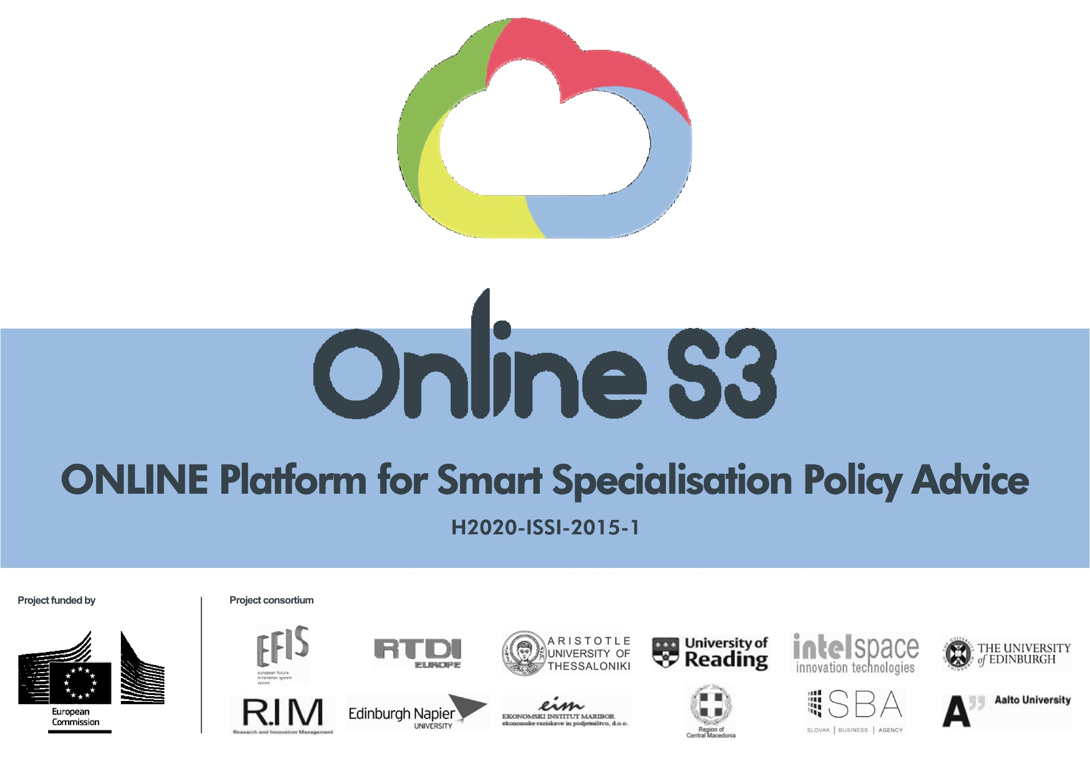



Slide 2

WP3: Online S3 Platform creation
WP4: Tools, apps and e-services
Nicos Komninos, URENIO Research, Aristotle University of Thessaloniki
Mona Roman, Aalto University
2nd Review Meeting, Brussels, 8 October 2018

Slide 3
Contents
WP 4: Tools, apps and e-services
  D4.1. Specifications of applications and tools – First version
  D4.2. Applications and tools second version
WP 3: Online S3 Platform creation
  D3.1. Platform design and prototype
  D3.2. Platform application and tools
  D3.3. Online S3 platform, applications and tools – Final version
Conclusions

Slide 4
WP 4: Tools, apps and e-services
  D4.1. Specifications of applications and tools – First version
  D4.2. Applications and tools second version
Process in W4 |  |  | iv. Development of V2
 |  | iii. Getting assessments
 | ii. Development of V1
i.Design of applications

Slide 5
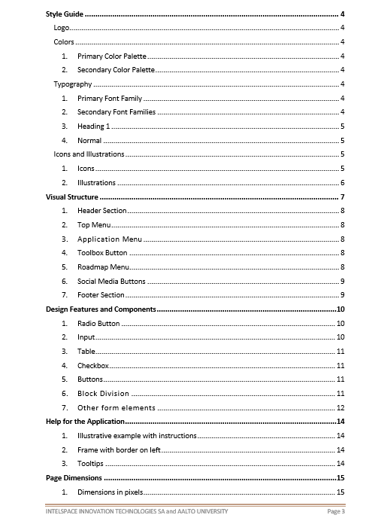
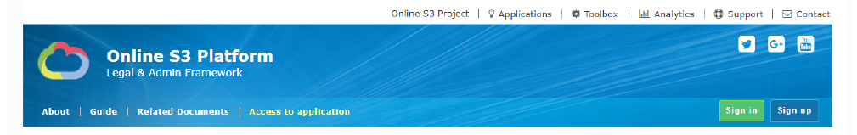
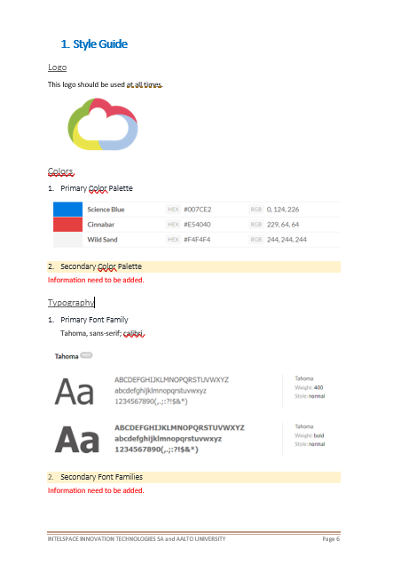
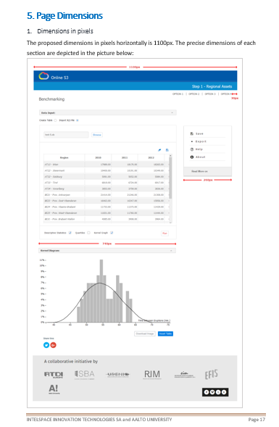
i. DESIGN OF APPLICATIONS: Design guide, common functional and aesthetics features

Slide 6
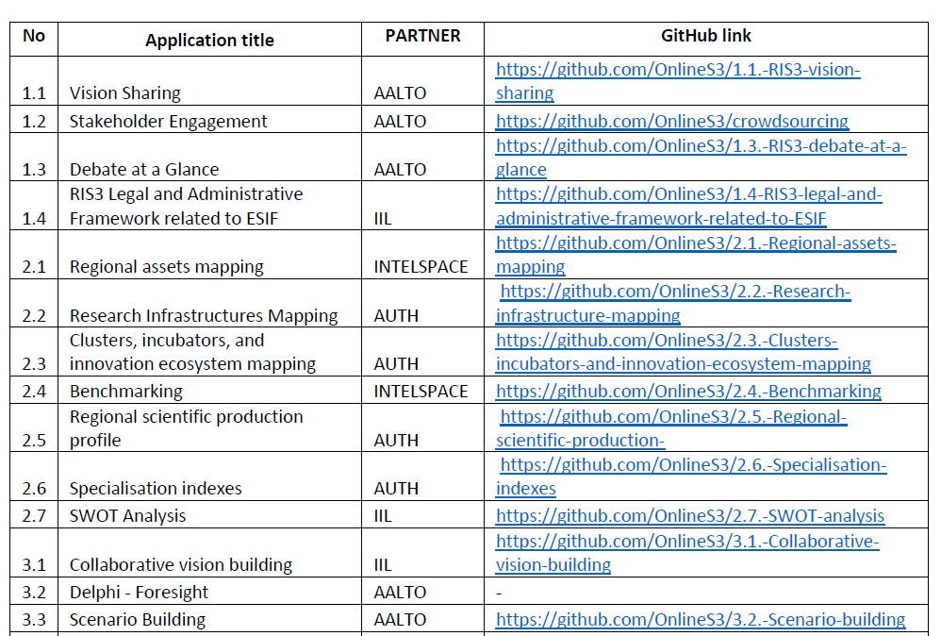
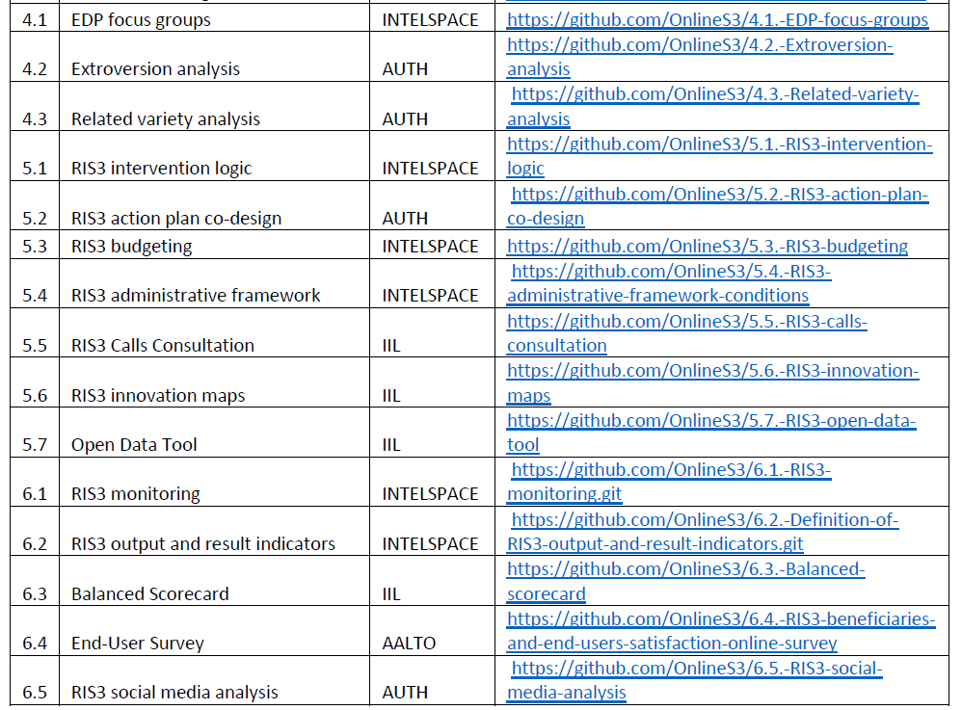
ii. DEVELOPMENT OF 29 APPLICATIONS V1
AALTO (6) | 1.1, 1.2, 1.3, 3.2, 3.3, 6.4 | INTELSPACE (8) | 2.1, 2.4, 4.1, 5.1, 5.3, 5.4, 6.1, 6.2
AUTH (8) | 2.2, 2.3, 2.5, 2.6, 4.2, 4.3, 5.2, 6.5 | IIL (7) | 1.4, 2.7, 3.1, 5.5, 5.6, 5.7, 6.3

Slide 7
1.4 Stakeholder engagement
PHASE 1: GOVERNANCE

Slide 8
PHASE 2: ANALYSIS OF CONTEXT

Slide 9
PHASE 3: STRATEGY FORMULATION

Slide 10
PHASE 4: PRIORITY SETTING

Slide 11
PHASE 5: POLICY MIX

Slide 12
PHASE 6: MONITORING & EVALUATION

Slide 13
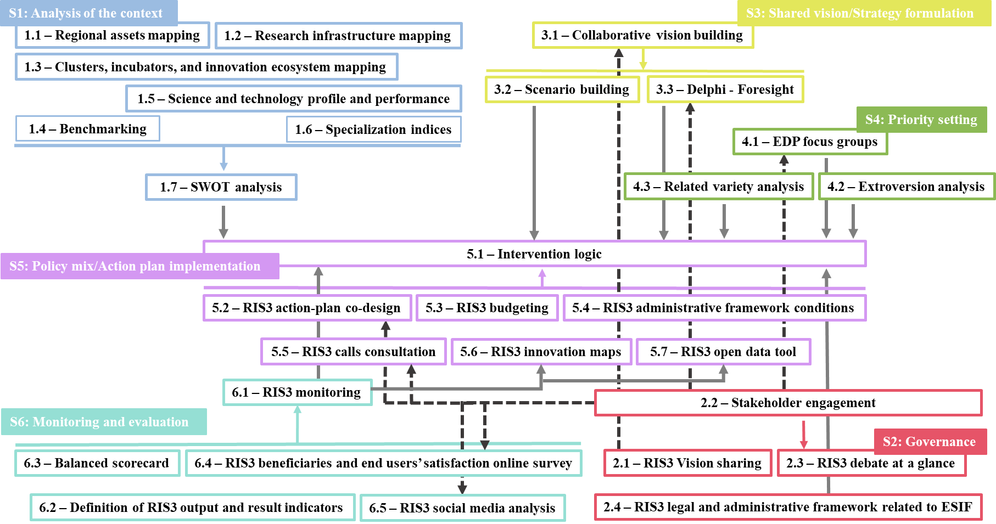
ii. DEVELOPMENT OF 29 APPLICATIONS V1 – The logic of interoperability

Slide 14
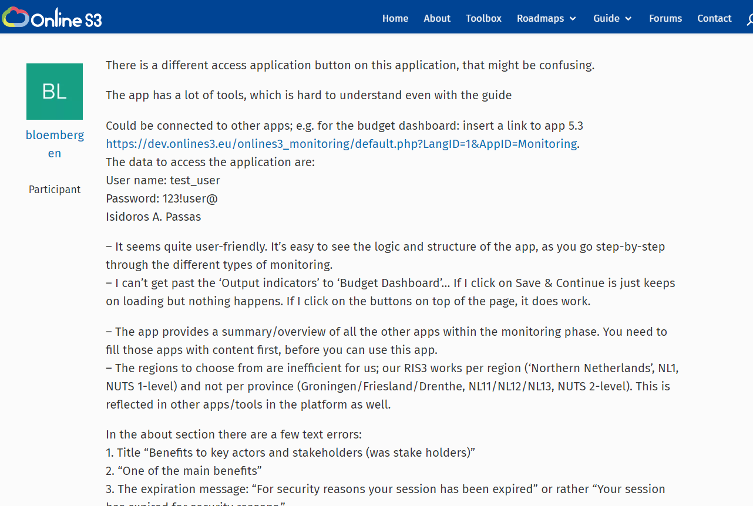
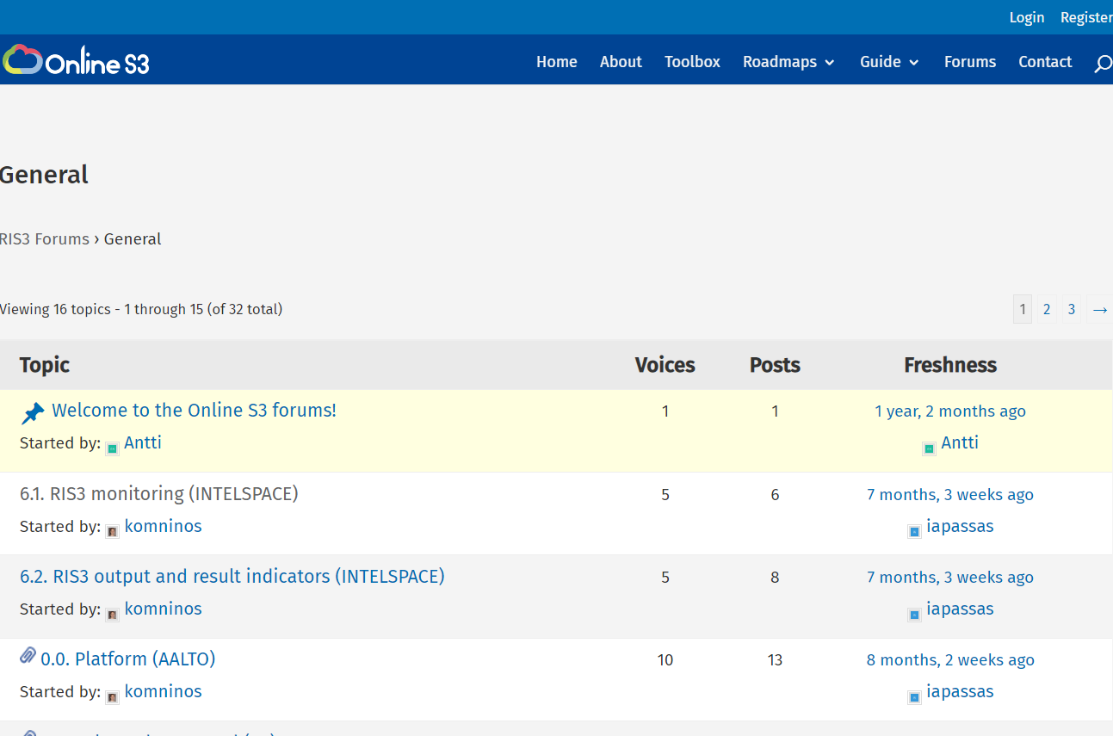
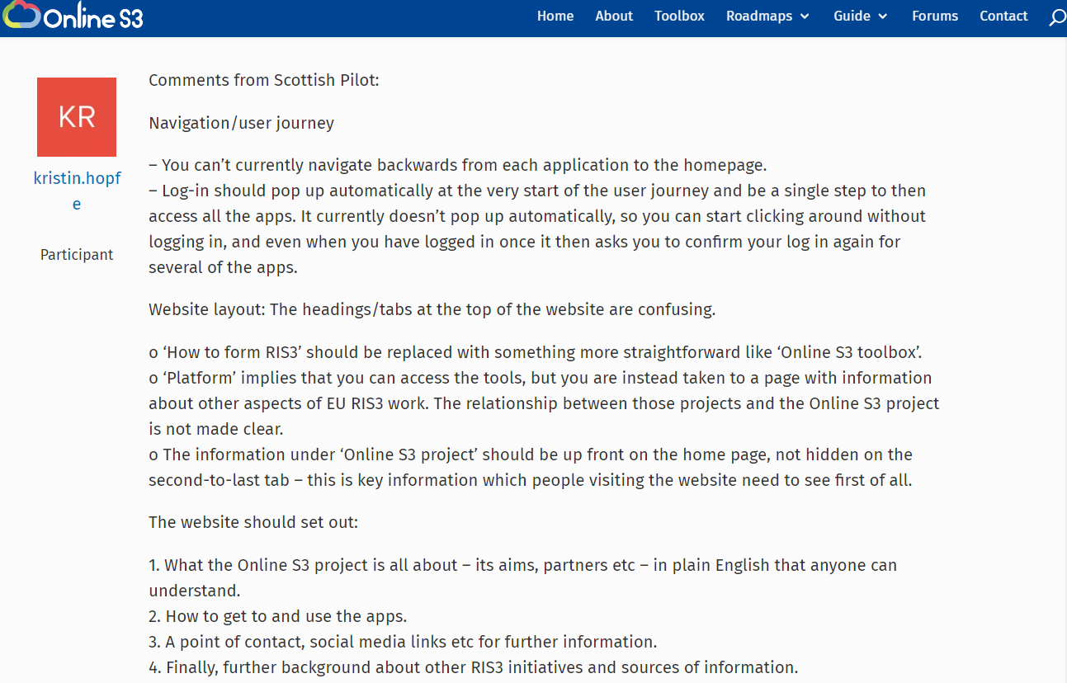
iii. GATHERING OF COMMENTS FOR IMPROVEMENT
FORUM ON THE PLATFORM:
31 topics, 152 comments for change were addressed

Slide 15
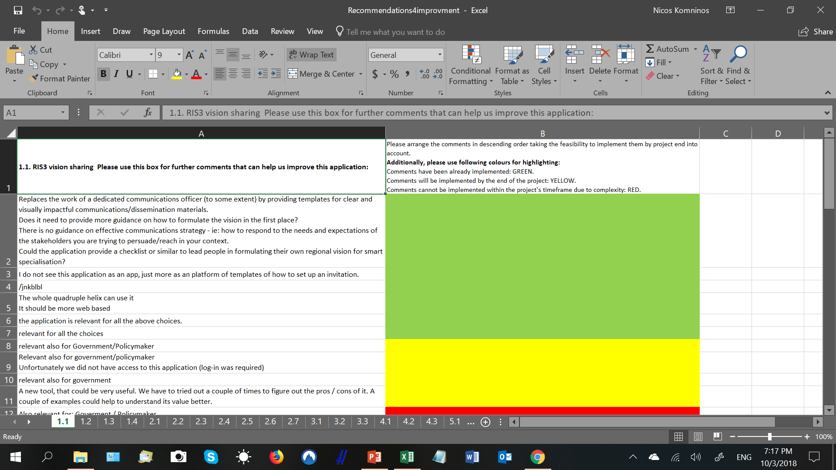
FROM THE PILOTS:
602 RECOMMENDATION FOR IMPROVEMENT

Slide 16
iv. DEVELOPMENT OF 28 APPLICATIONS V2 and 4 ROADMAPS
September 2017-April 2018 |  |  | Final version 28 applications
 |  | Recommendations from testing phase 2
 | Recommendations from testing phase 1
Self assessment

Slide 17
FOUR ROADMAPS

Slide 18
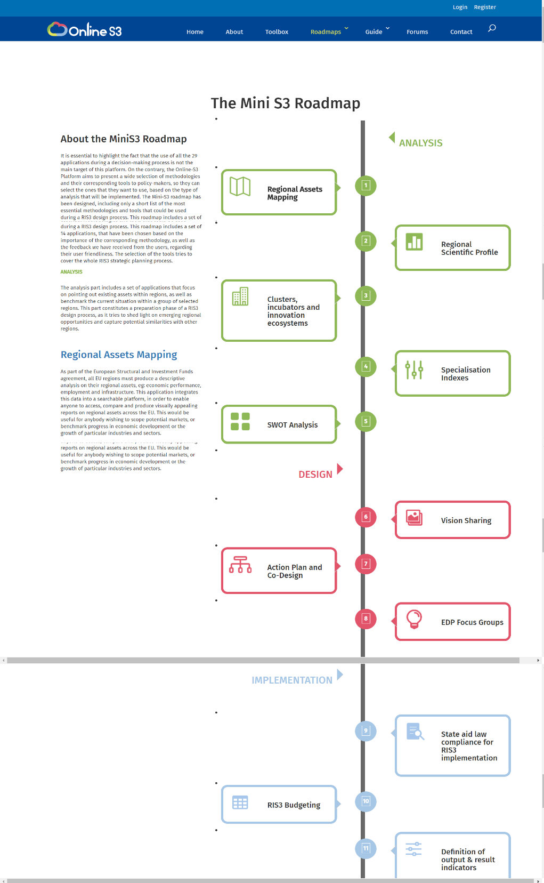
Roadmap: Mini S3
The use of all the 29 applications during a decision-making process is not the main target of this platform.
The Online-S3 Platform present a wide selection of methodologies to policy-makers, so they can select the ones that they want to use
The Mini-S3 roadmap includes only a short list of the most essential methodologies and tools that could be used during a RIS3 design process.

Slide 19
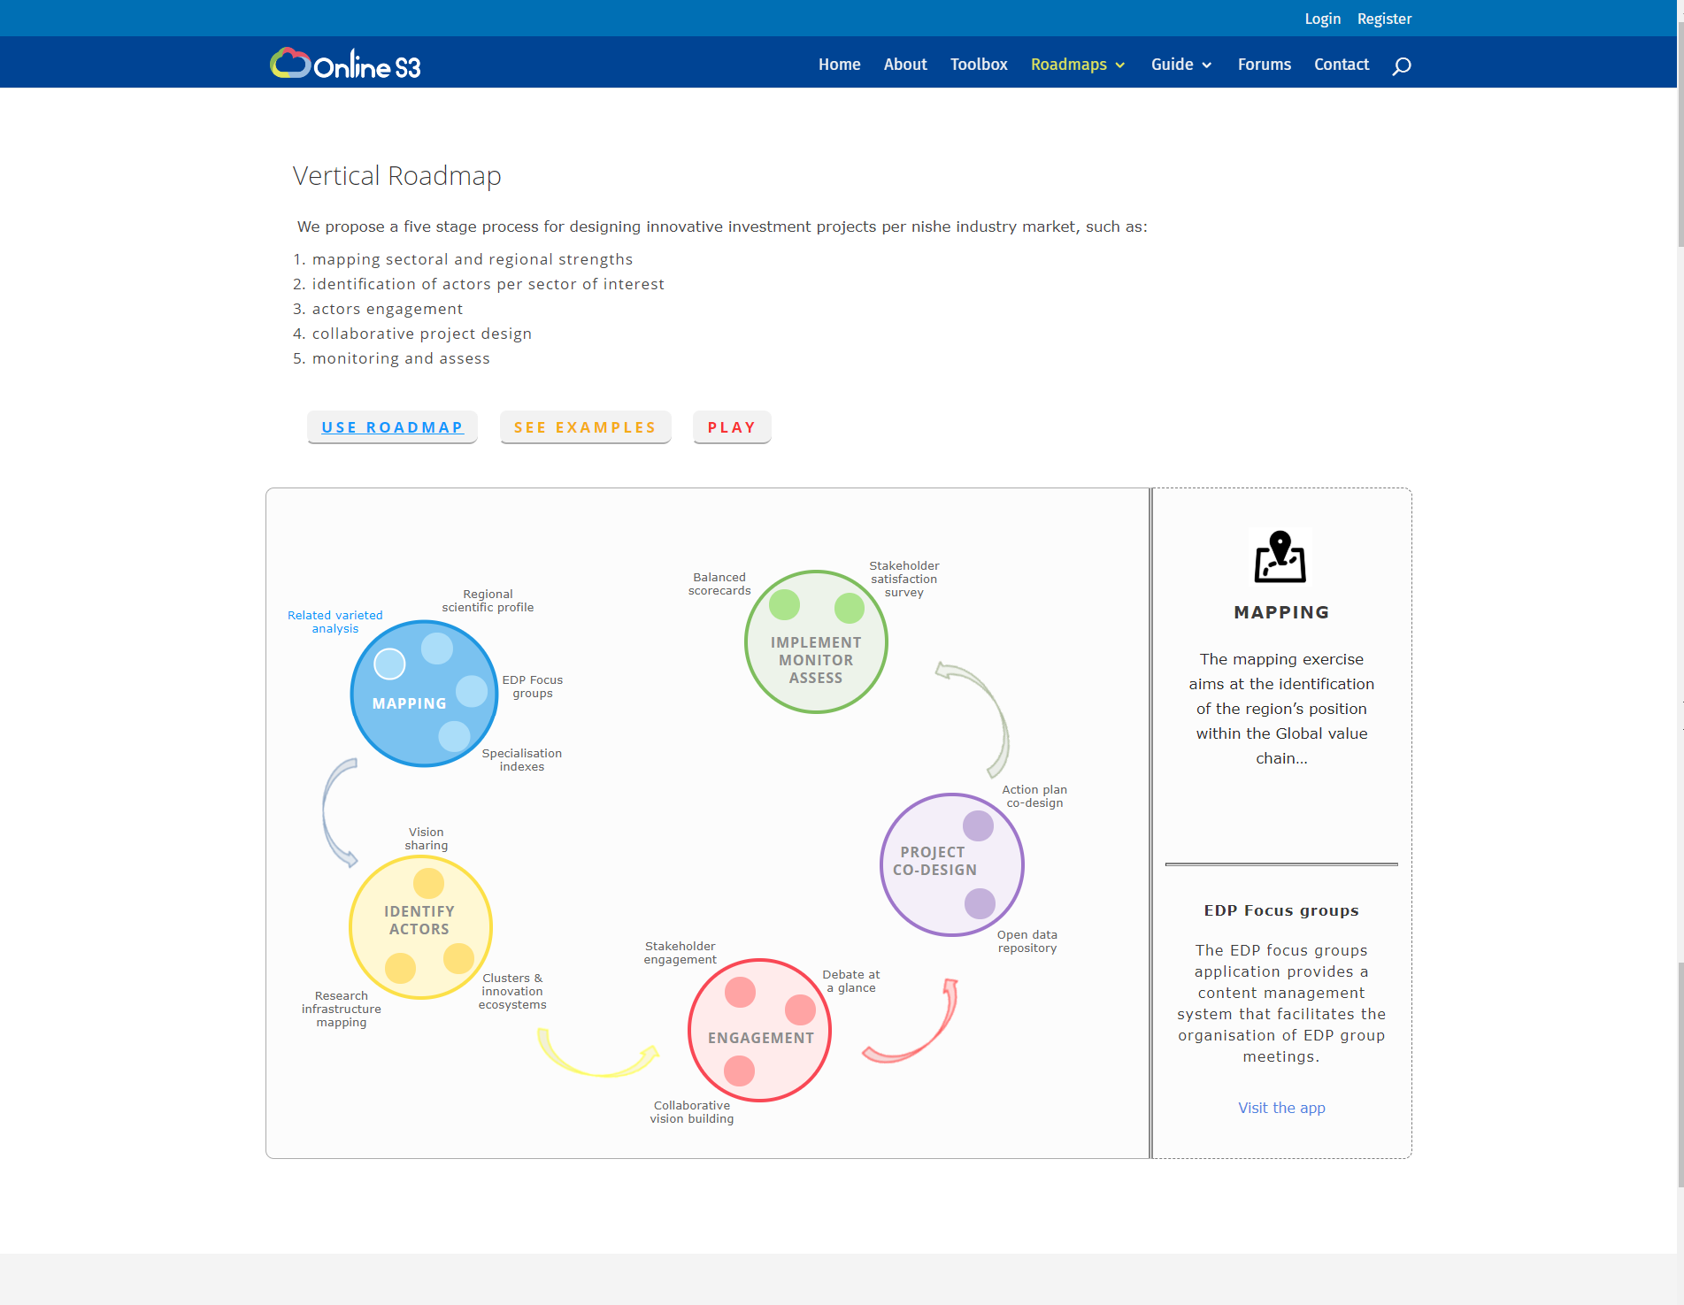
Roadmap: Vertical
A five stage process for designing innovative investment projects per niche industry market, such as:
Mapping sectoral and regional strengths
Identification of actors per sector of interest
Actors engagement
Collaborative project design
Monitoring and assess

Slide 20
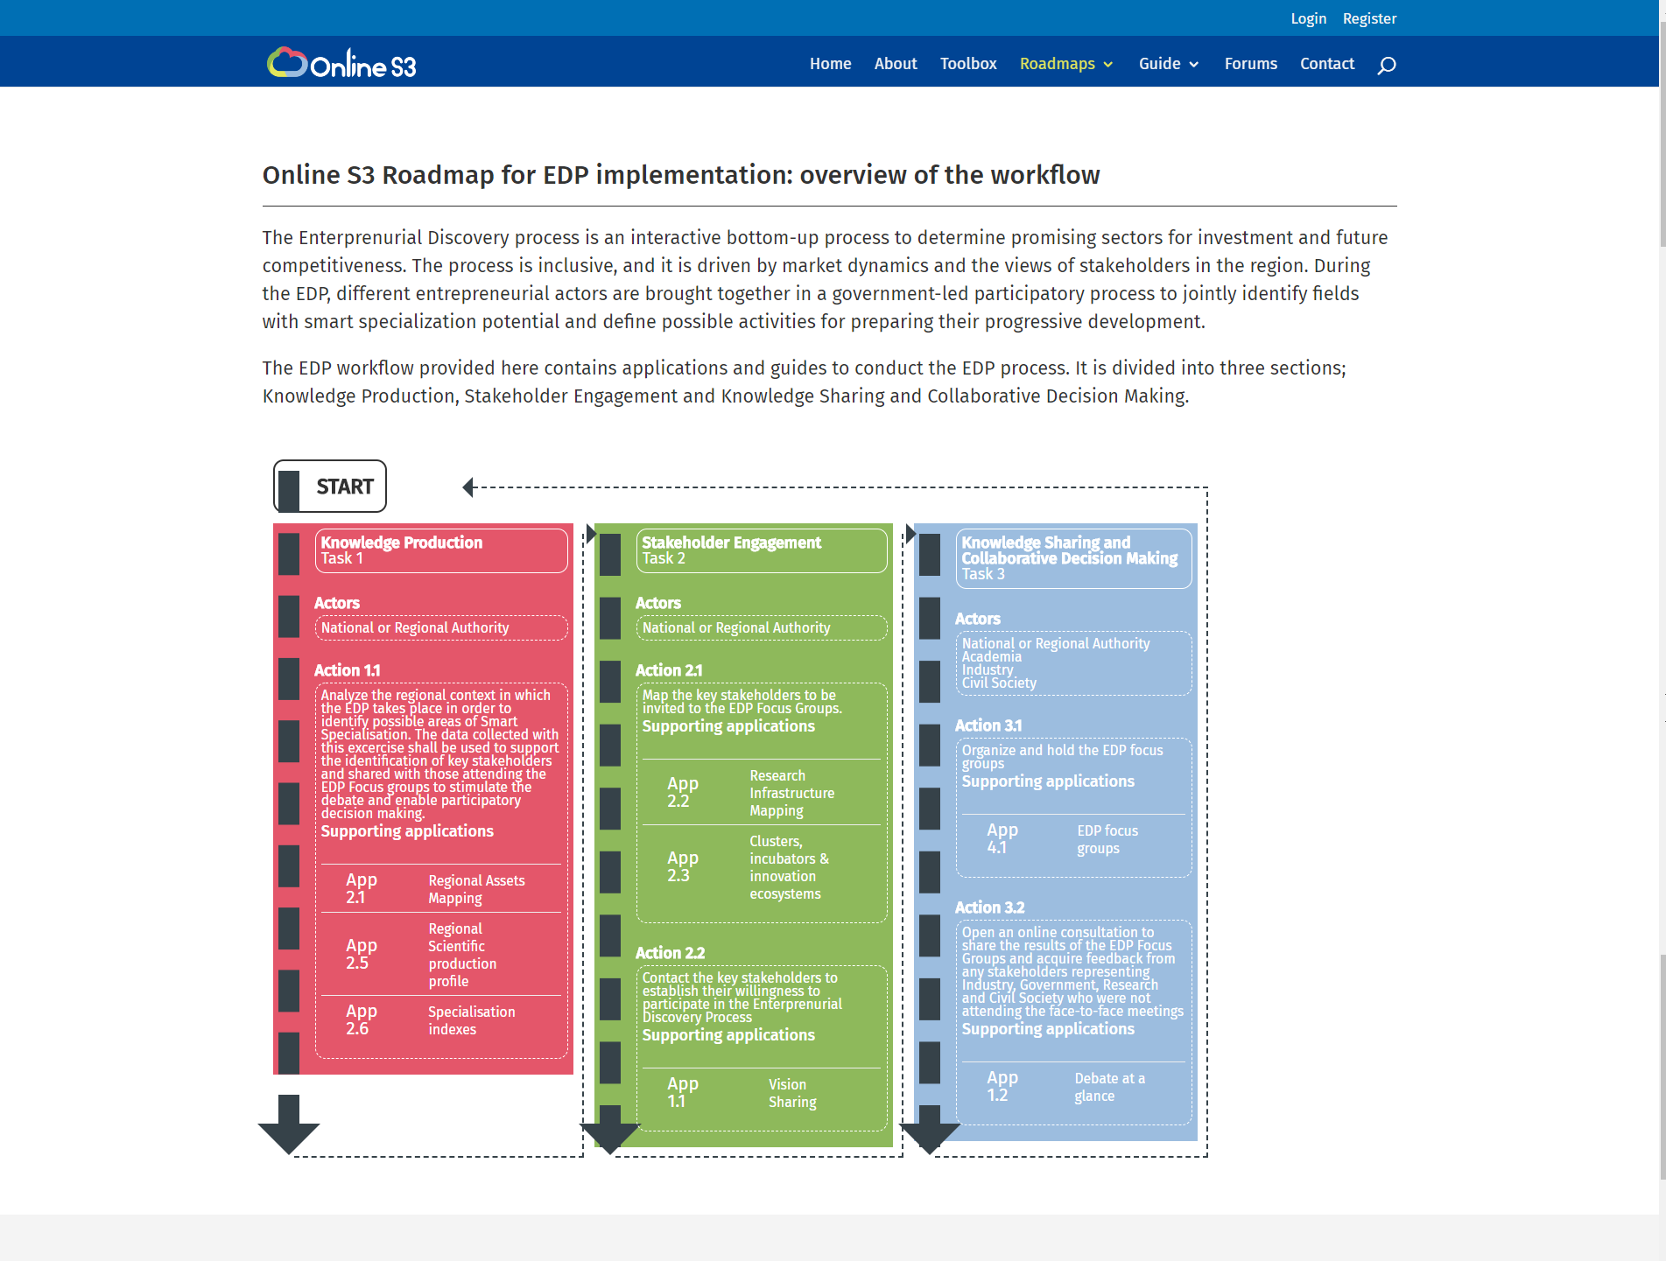
Roadmap: EDP
The EDP workflow provided here contains applications and guides to conduct the EDP process.
It is divided into three sections;
Knowledge Production,
Stakeholder Engagement and
Knowledge Sharing and Collaborative Decision Making.

Slide 21
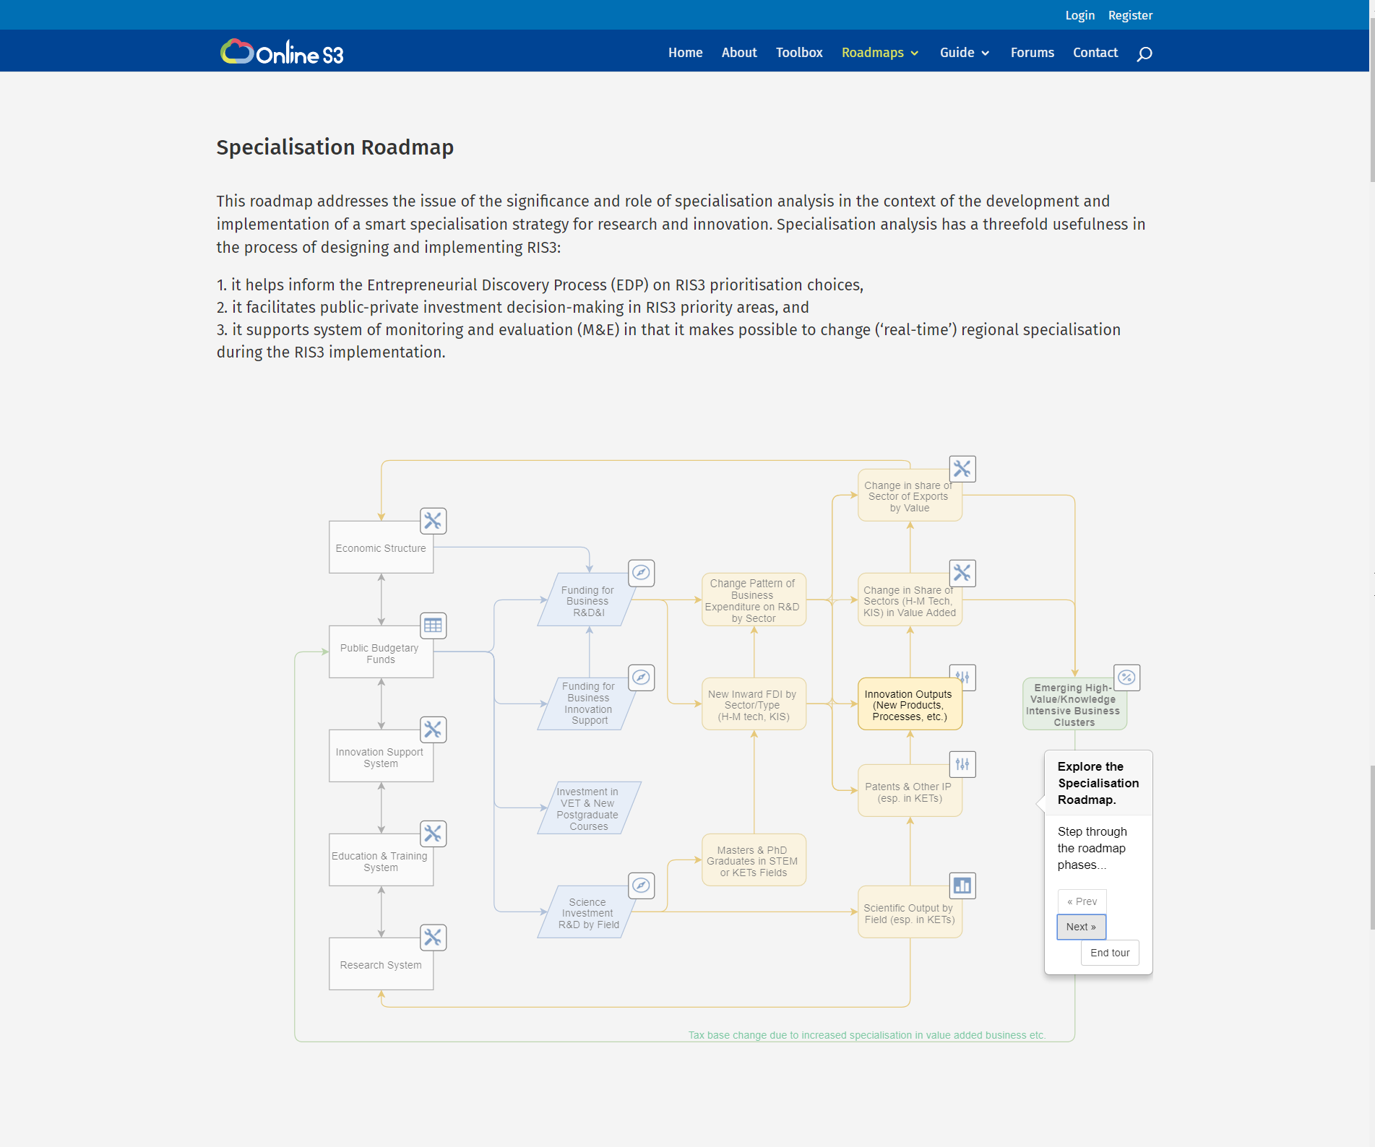
Roadmap: Specialisation
A conceptual framework for specialisation analysis and accompanying methods for conducting it are presented.
Moreover, it is shown how specialisation analysis could be done by a selection of 10 Online S3 applications.

Slide 22
WP 3: Online S3 Platform creation
  D3.1. Platform design and prototype
  D3.2. Platform application and tools
  D3.3. Online S3 platform, applications and tools – Final version

Slide 23
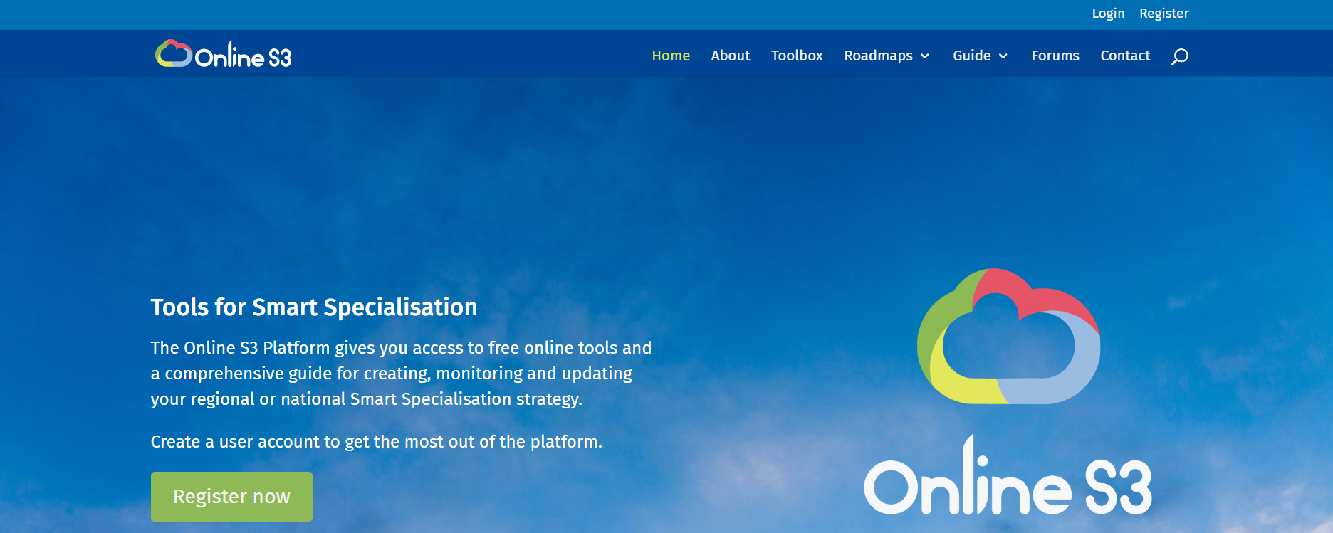
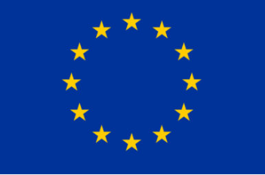
H2020 project
A Platform for Smart Specialisation Policy Design

Slide 26
Conclusions

Slide 27
Meet the objectives and beyond
Applications
Platform

Slide 28

http://www.onlines3.eu
Thank you for your attention

