Slide 1
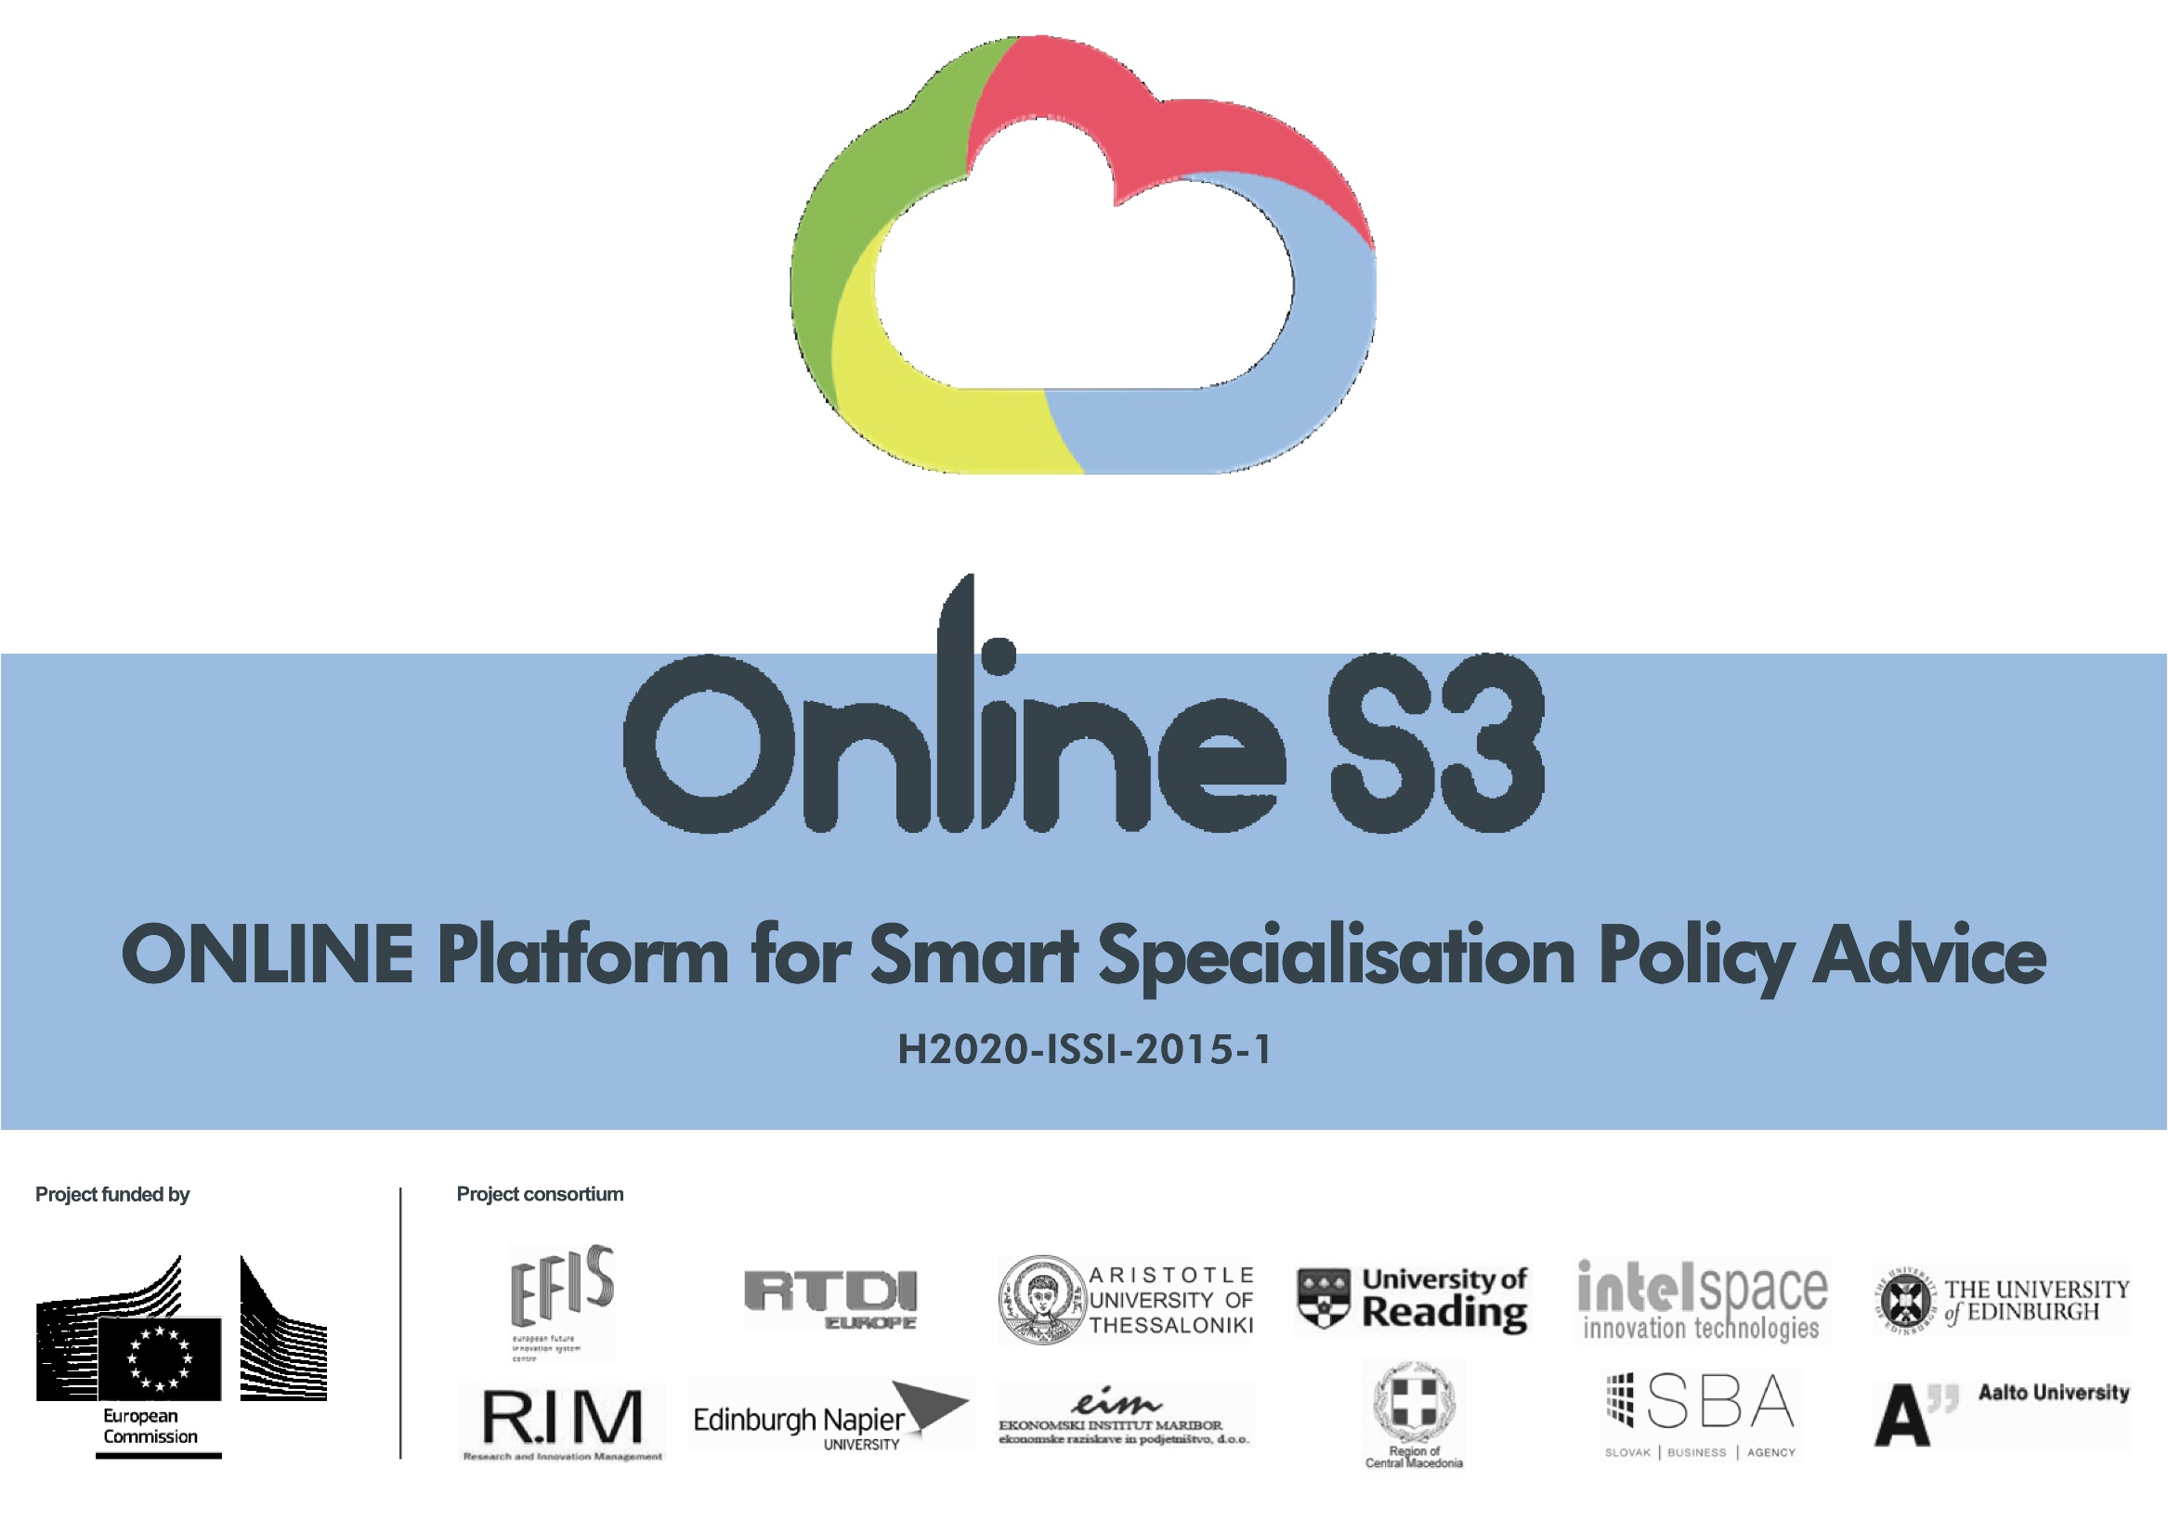



Slide 2

WP3: Online S3 Platform creation
WP4: Tools, apps and e-services
Nicos Komninos, URENIO Research, Aristotle University of Thessaloniki
Mona Roman, Aalto University
2nd Review Meeting, Brussels, 8 October 2018

Slide 3
Contents
WP 4: Tools, apps and e-services
  D4.1. Specifications of applications and tools – First version
  D4.2. Applications and tools second version
WP 3: Online S3 Platform creation
  D3.1. Platform design and prototype
  D3.2. Platform, application and tools
  D3.3. Online S3 platform, applications and tools – Final version
Conclusions

Slide 4
WP 4: Tools, apps and e-services
  D4.1. Specifications of applications and tools – First version
  D4.2. Applications and tools second version
Process in W4 |  |  | iv. Development of V2
 |  | iii. Getting assessments
 | ii. Development of V1
i.Design of applications

Slide 5
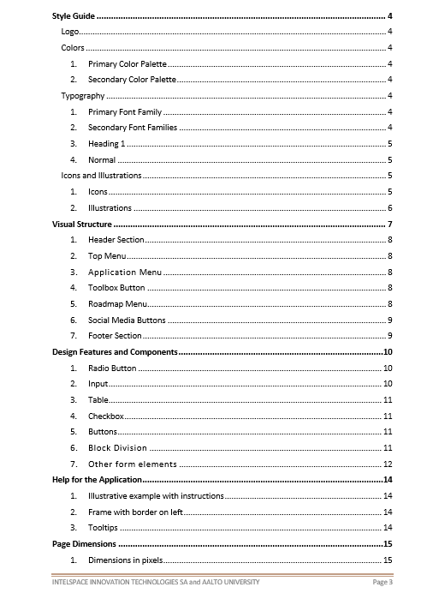
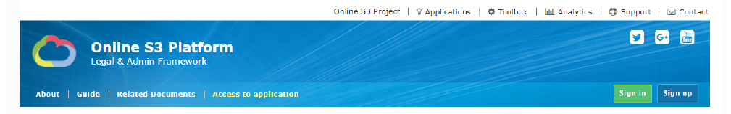
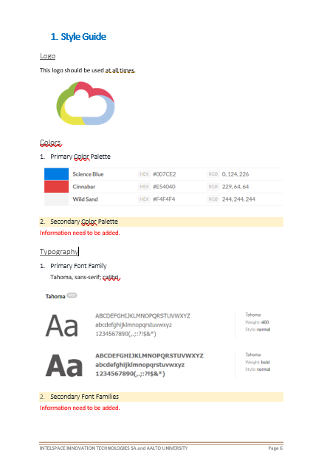
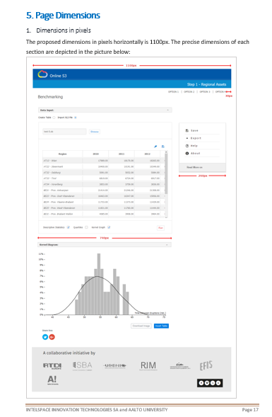
i. DESIGN OF APPLICATIONS: Design guide, common functional and aesthetics features

Slide 6
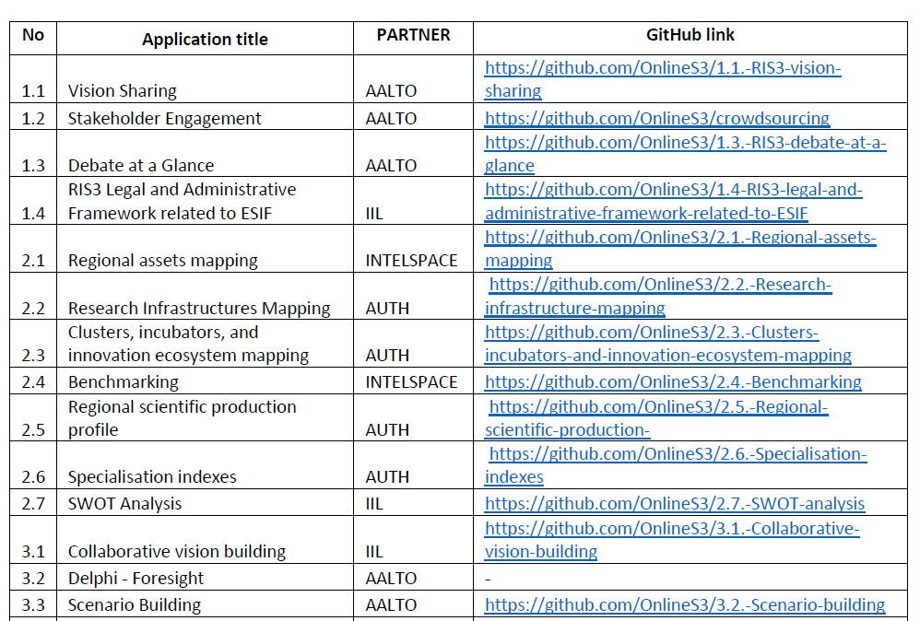
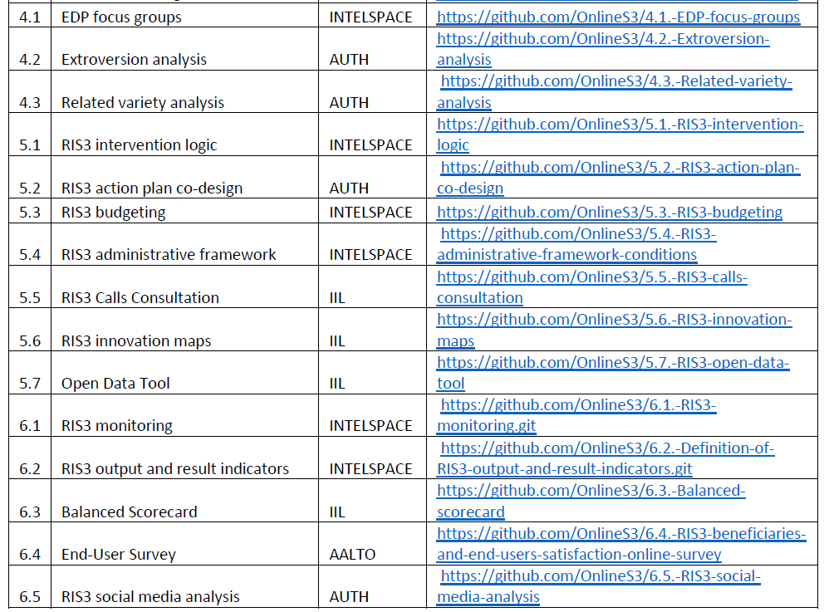
ii. DEVELOPMENT OF 29 APPLICATIONS V1
AALTO (6) | 1.1, 1.2, 1.3, 3.2, 3.3, 6.4 | INTELSPACE (8) | 2.1, 2.4, 4.1, 5.1, 5.3, 5.4, 6.1, 6.2
AUTH (8) | 2.2, 2.3, 2.5, 2.6, 4.2, 4.3, 5.2, 6.5 | IIL (7) | 1.4, 2.7, 3.1, 5.5, 5.6, 5.7, 6.3

Slide 7
1.4 Stakeholder engagement
PHASE 1: GOVERNANCE

Slide 8
PHASE 2: ANALYSIS OF CONTEXT

Slide 9
PHASE 3: STRATEGY FORMULATION

Slide 10
PHASE 4: PRIORITY SETTING

Slide 11
PHASE 5: POLICY MIX

Slide 12
PHASE 6: MONITORING & EVALUATION

Slide 13
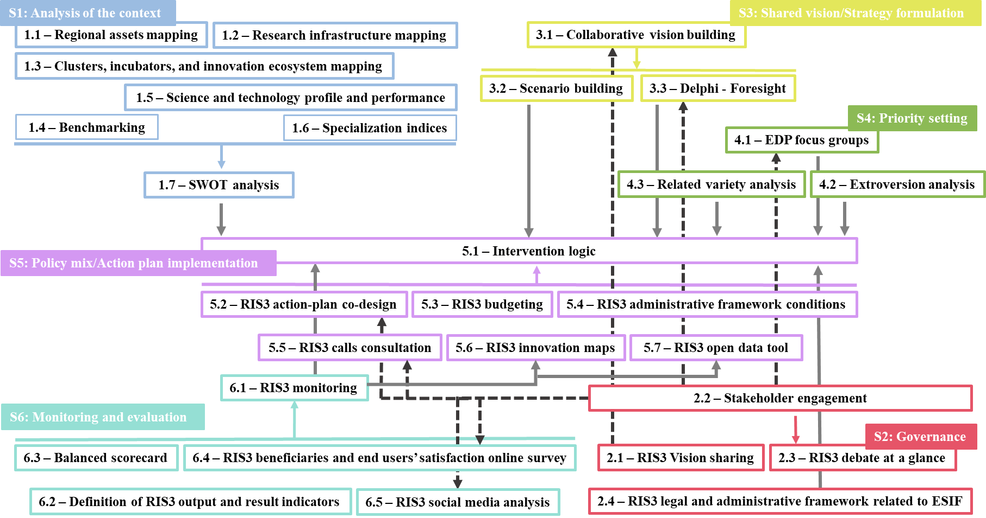
ii. DEVELOPMENT OF 29 APPLICATIONS V1 – The logic of interoperability

Slide 14
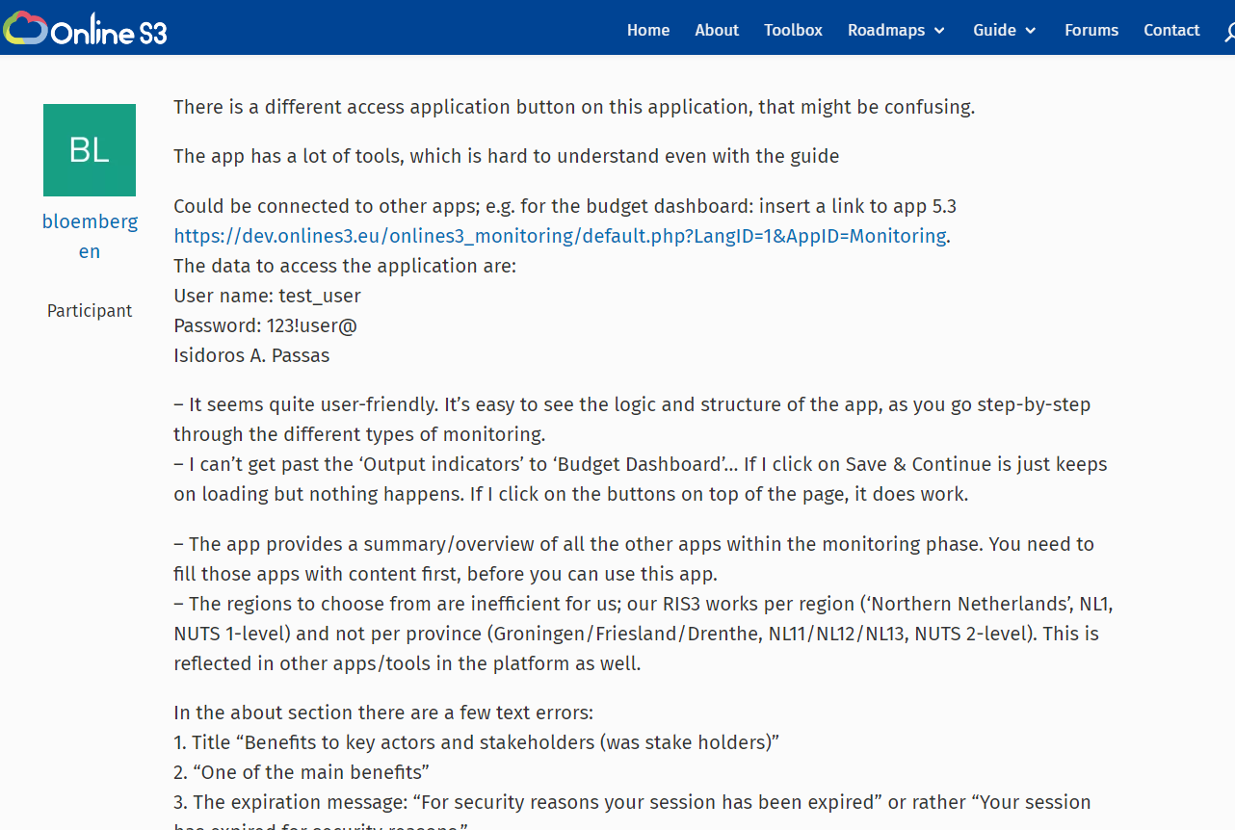
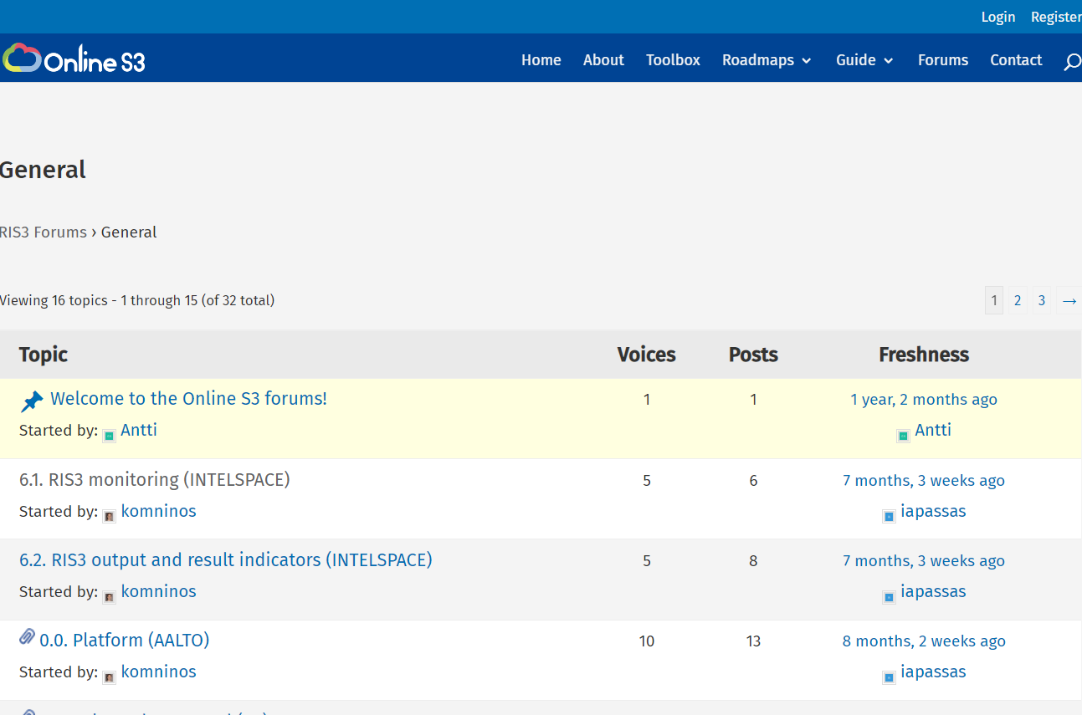
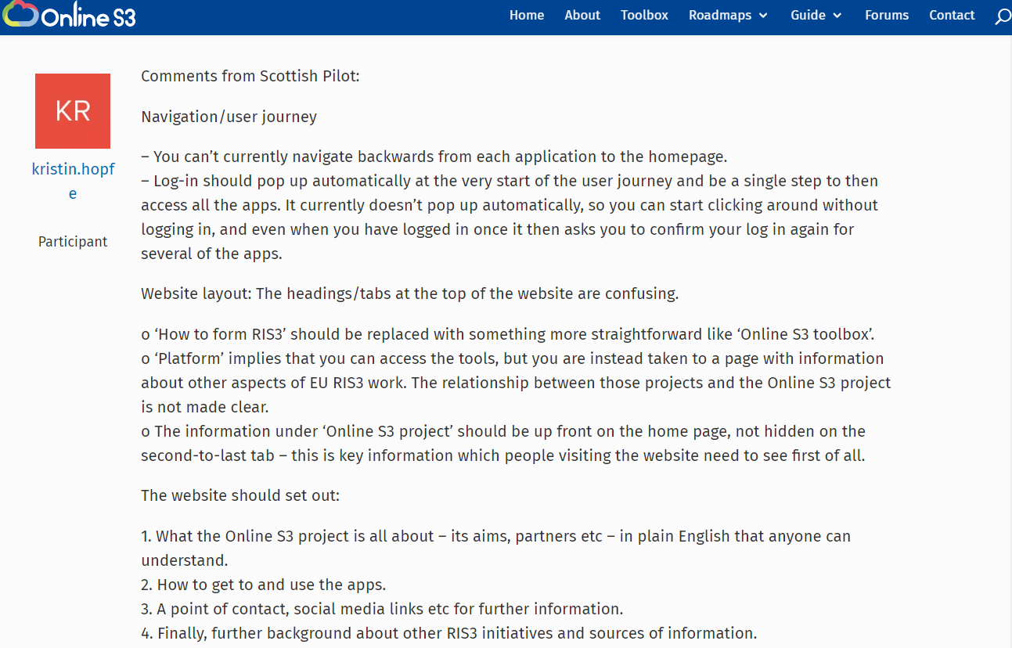
iii. GATHERING OF COMMENTS FOR IMPROVEMENT
FORUM ON THE PLATFORM:
31 topics, 152 comments for change were addressed

Slide 15
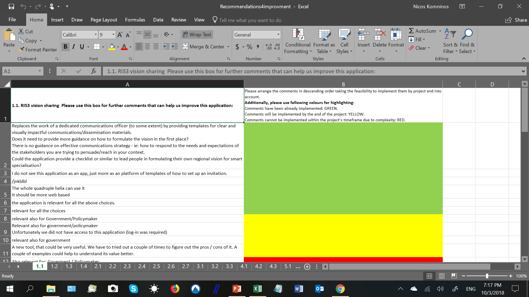
FROM THE PILOTS:
602 RECOMMENDATION FOR IMPROVEMENT

Slide 16
iv. DEVELOPMENT OF 28 APPLICATIONS V2 and 4 ROADMAPS
September 2017-April 2018 |  |  | Final version 28 applications
 |  | Recommendations from testing phase 2
 | Recommendations from testing phase 1
Self assessment

Slide 17
FOUR ROADMAPS

Slide 18
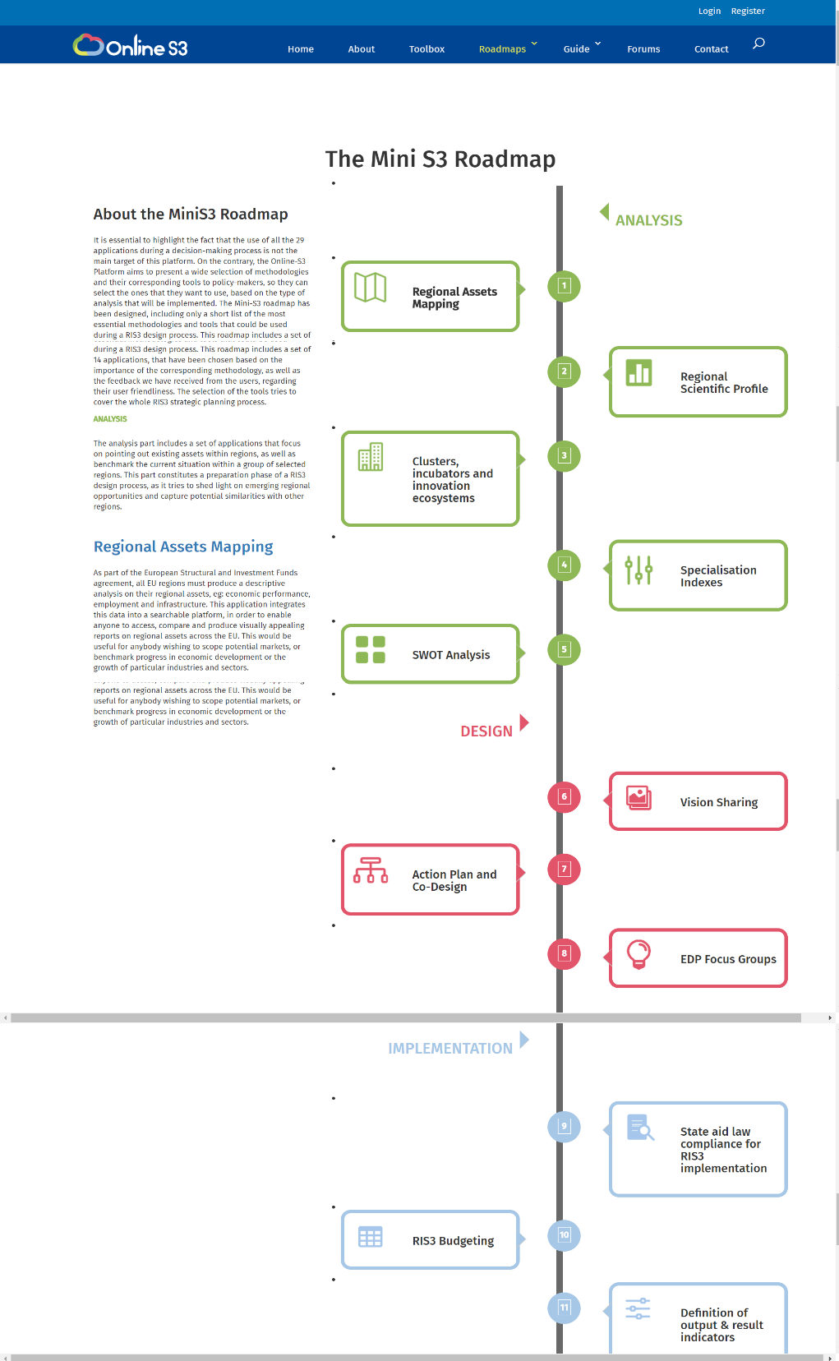
Roadmap: Mini S3
The use of all the 28 applications during a decision-making process is not the main target of this platform.
The Online-S3 Platform present a wide selection of methodologies to policy-makers, so they can select the ones that they want to use
The Mini-S3 roadmap includes only a short list of the most essential methodologies and tools that could be used during a RIS3 design process.

Slide 19
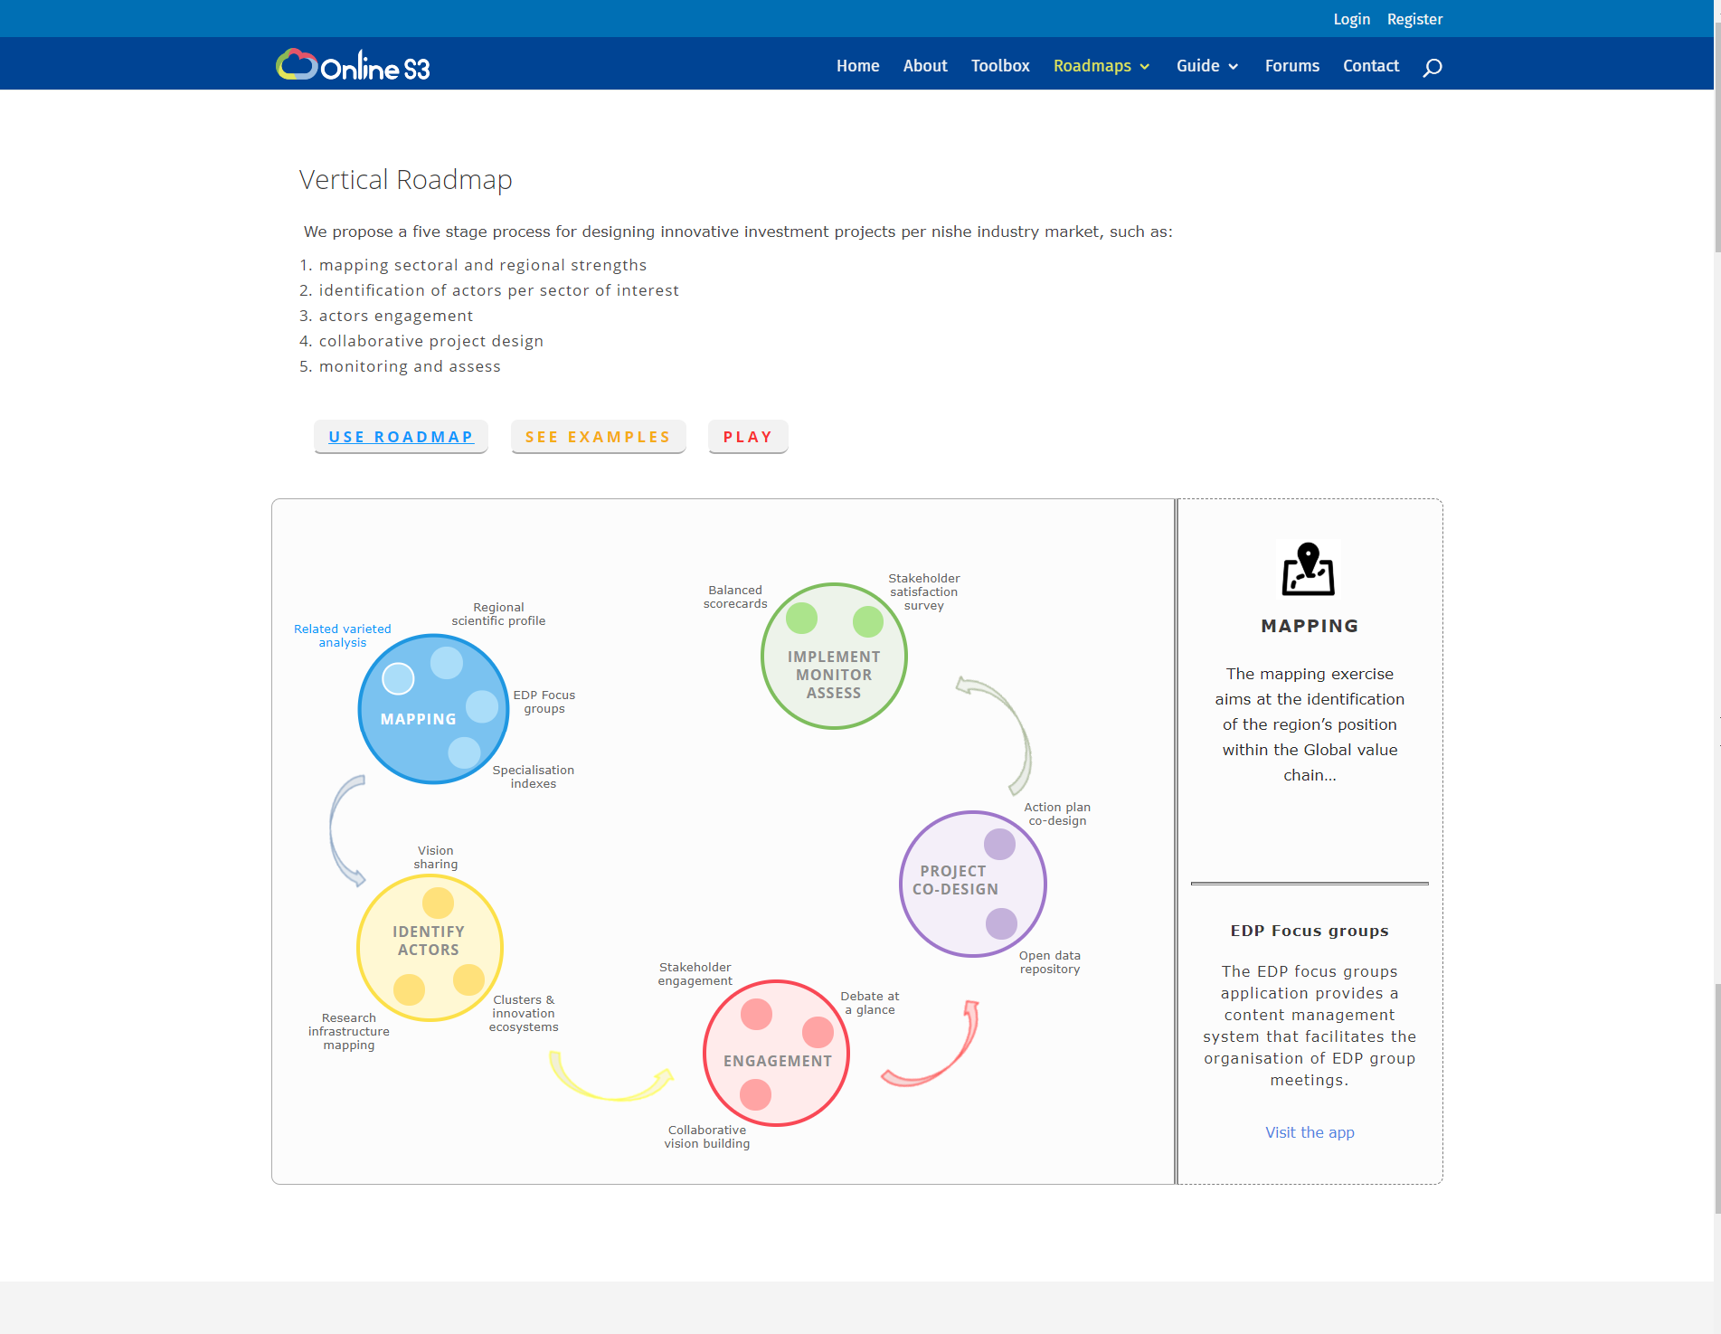
Roadmap: Vertical
A five stage process for designing innovative investment projects per niche industry market, such as:
Mapping sectoral and regional strengths
Identification of actors per sector of interest
Actors engagement
Collaborative project design
Monitoring and assess

Slide 20
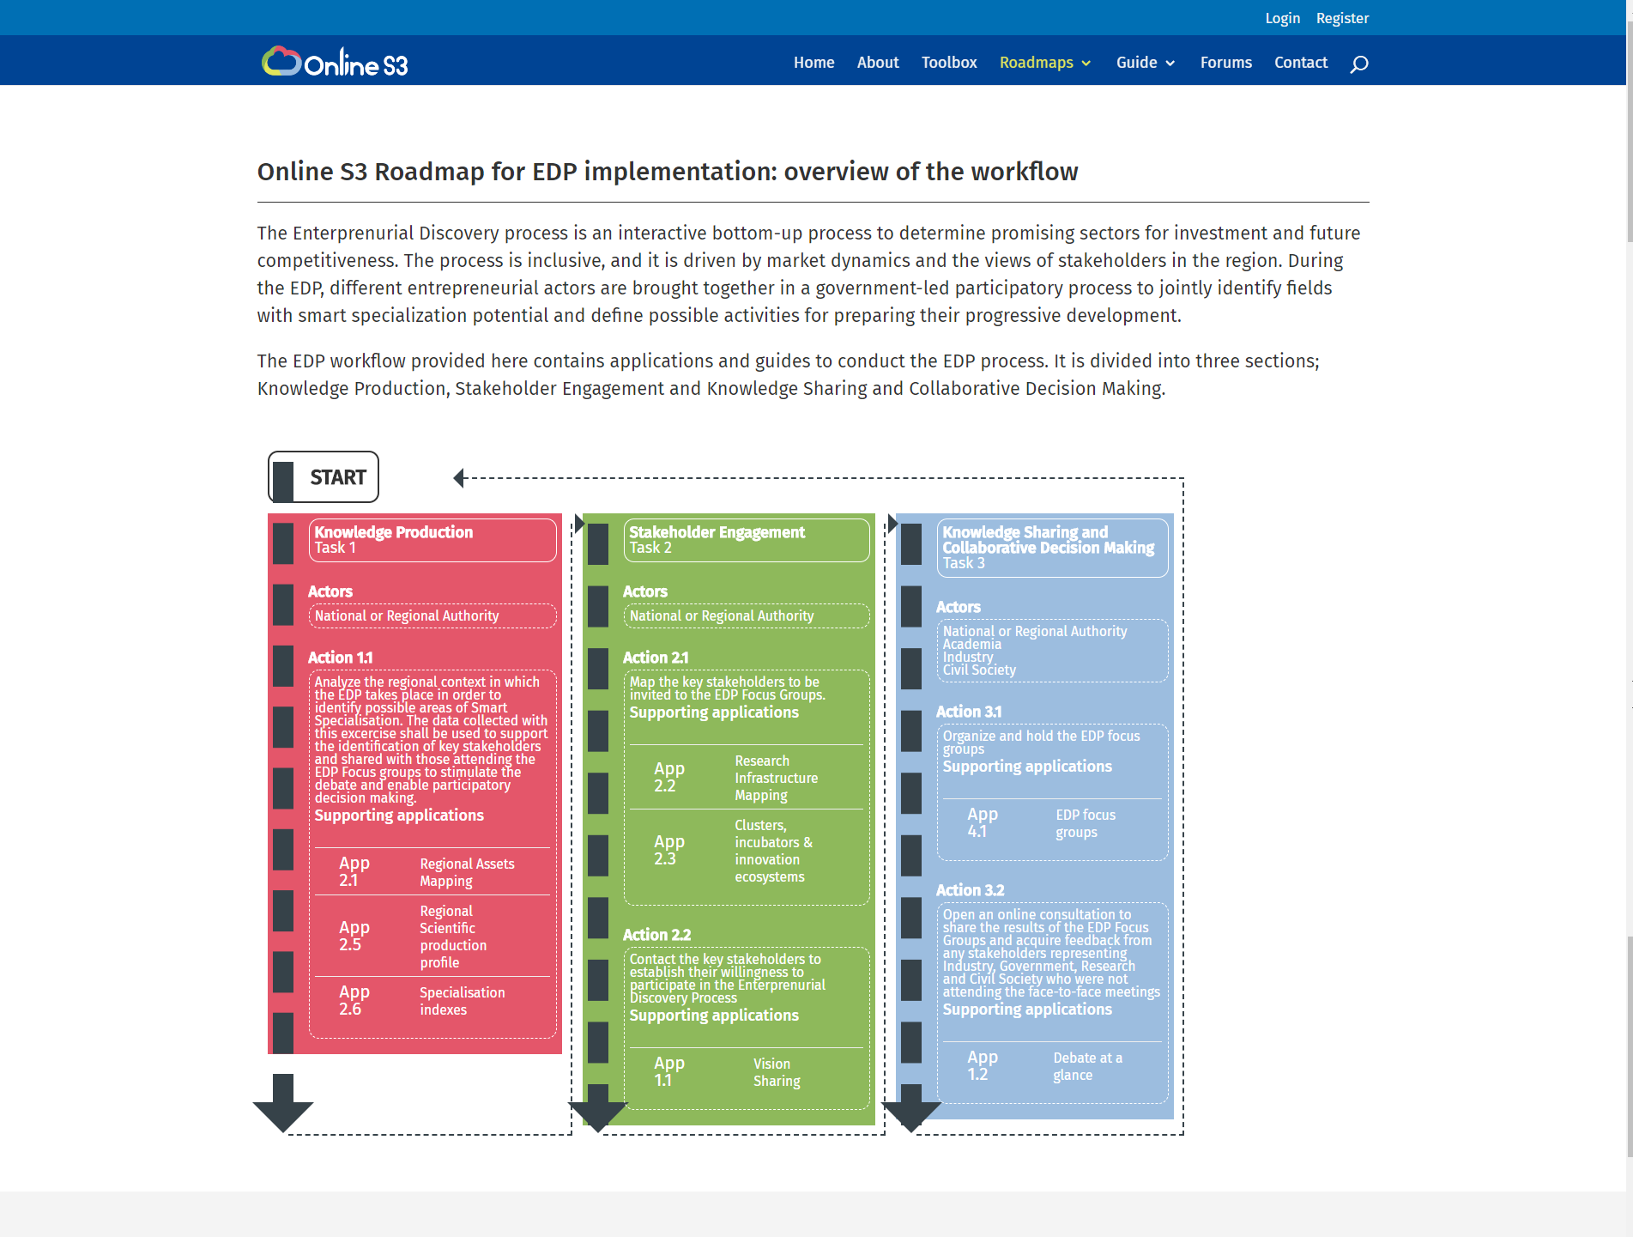
Roadmap: EDP
The EDP workflow provided here contains applications and guides to conduct the EDP process.
It is divided into three sections;
Knowledge Production,
Stakeholder Engagement and
Knowledge Sharing and Collaborative Decision Making.

Slide 21
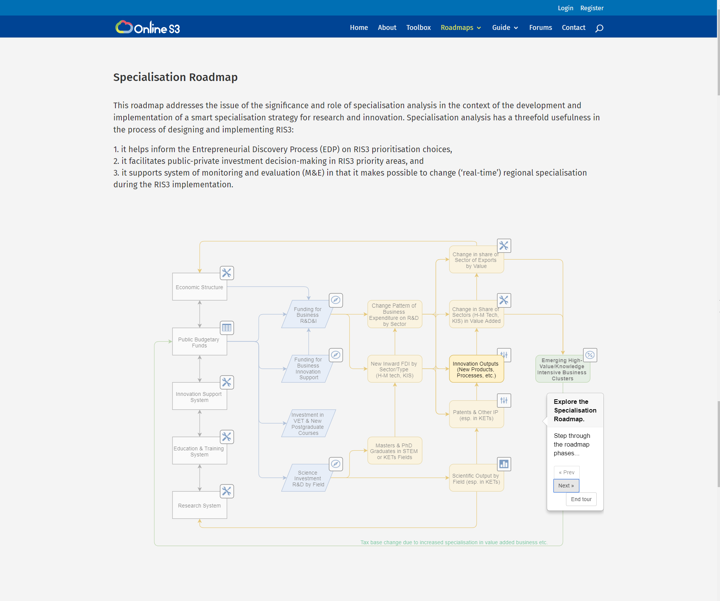
Roadmap: Specialisation
A conceptual framework for specialisation analysis and accompanying methods for conducting it are presented.
Moreover, it is shown how specialisation analysis could be done by a selection of 10 Online S3 applications.

Slide 22
WP 3: Online S3 Platform creation
  D3.1. Platform design and prototype
  D3.2. Platform, applications and tools
  D3.3. Online S3 platform, applications and tools – Final version
Process in WP3 |  |  | iv. Development of V2
 |  | iii. Getting assessments
 | ii. Development of V1
i.Design of platform

Slide 23
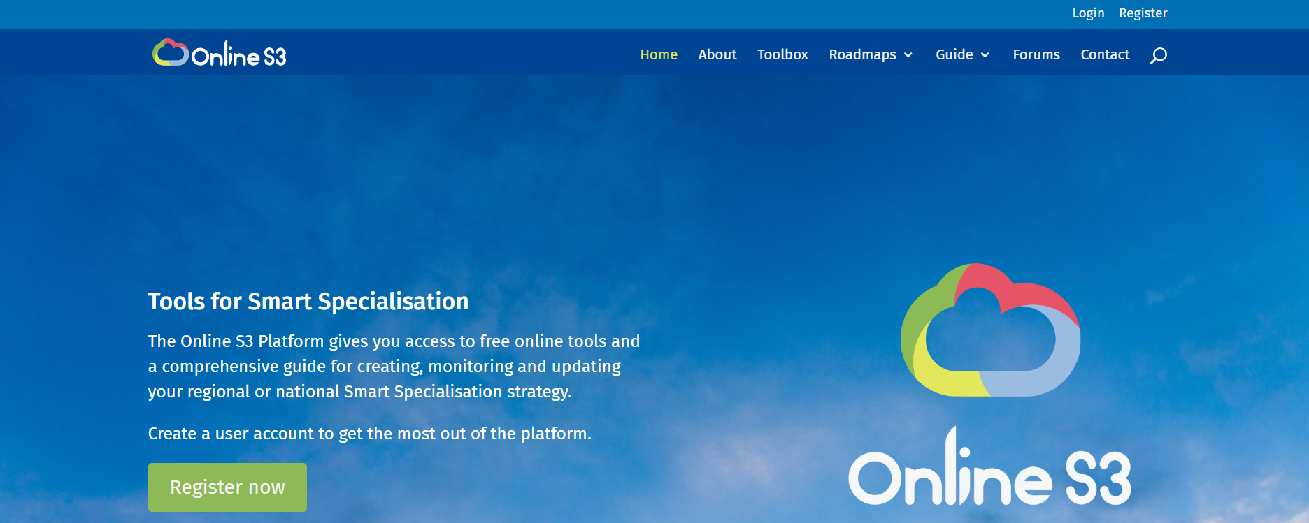
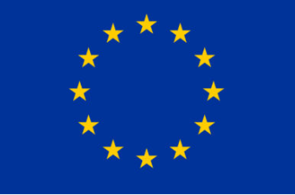
H2020 project
A Platform for Smart Specialisation Policy Design

Slide 24
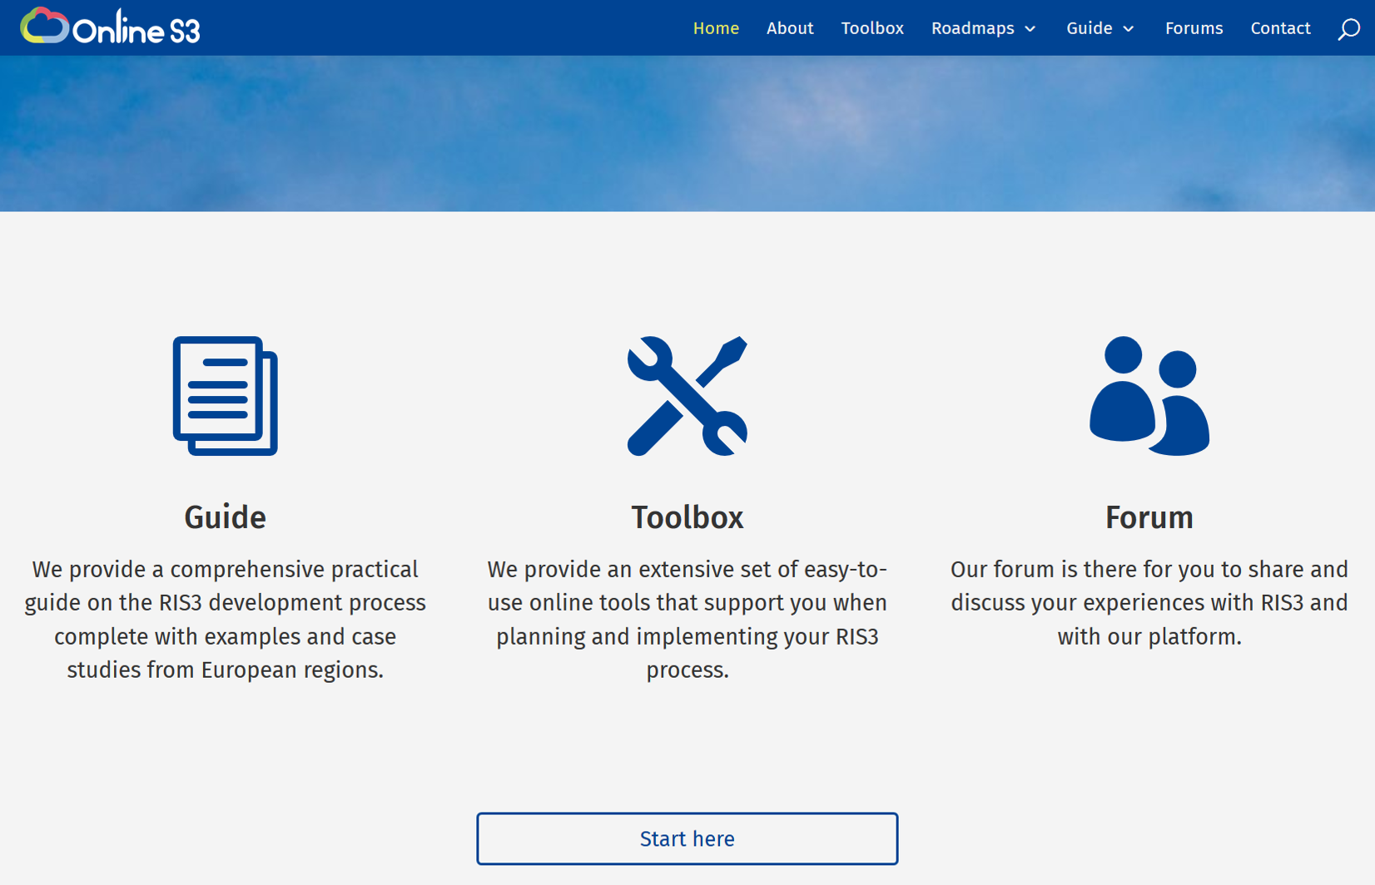
Main functions: Guide, Toolbox, Forum

Slide 25
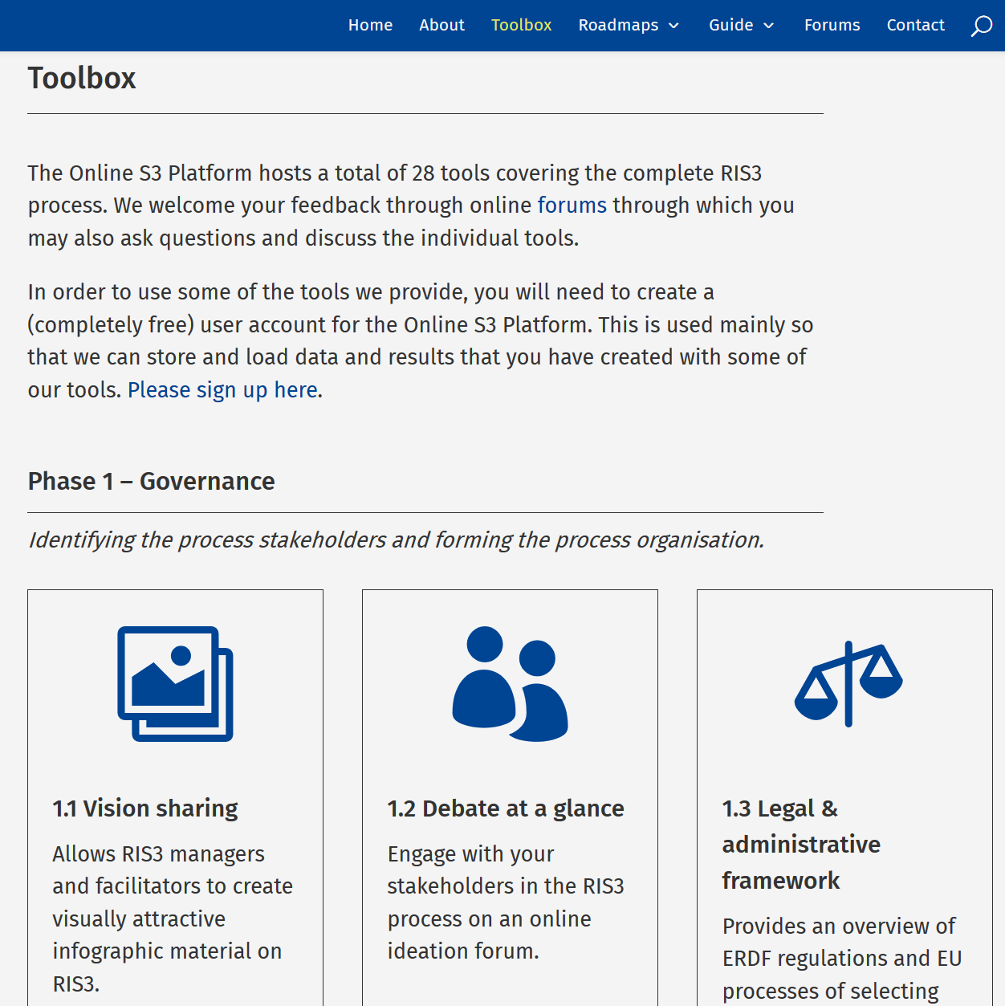
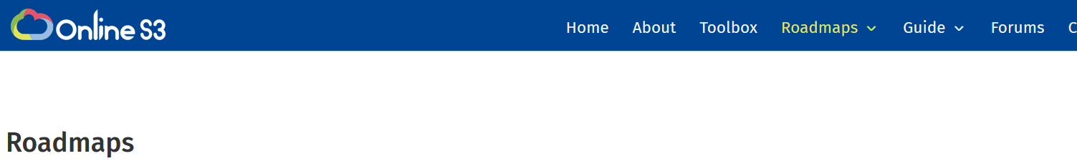
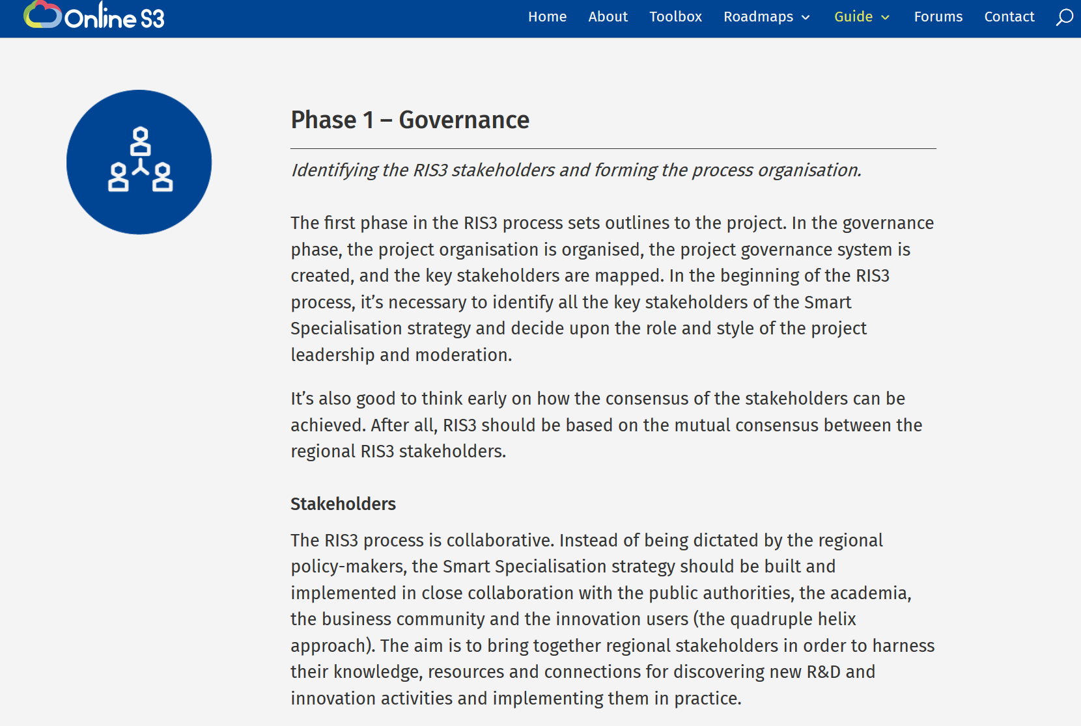
Three ways to access tools – Toolbox, Roadmaps, Process Guide

Slide 26
Collecting feedback for improvement
August 2017
Through questionnaire for technical partners (Intelspace, Urenio and IIL) regarding the content, styling, usability and the technical aspects of first version of ONLINE S3 platform
September-January 2017
Through ONLINE-S3 platform Forum section (open for everyone)
November 2017
Through freely formulated document from ONLINE S3 pilots (Galicia, Northern Netherlands, Scotland and Central Macedonia)
December 2017 – March 2018
Through stakeholder questionnaire filled by the pilot stakeholders in workshops etc. during the testing period
In addition,
Feedback gathered from JRC through meetings in December 2016, June 2017, February 2018 and from 18 Finnish regional councils through two rounds of interviews in September 2016 and August-October 2017.

Slide 27
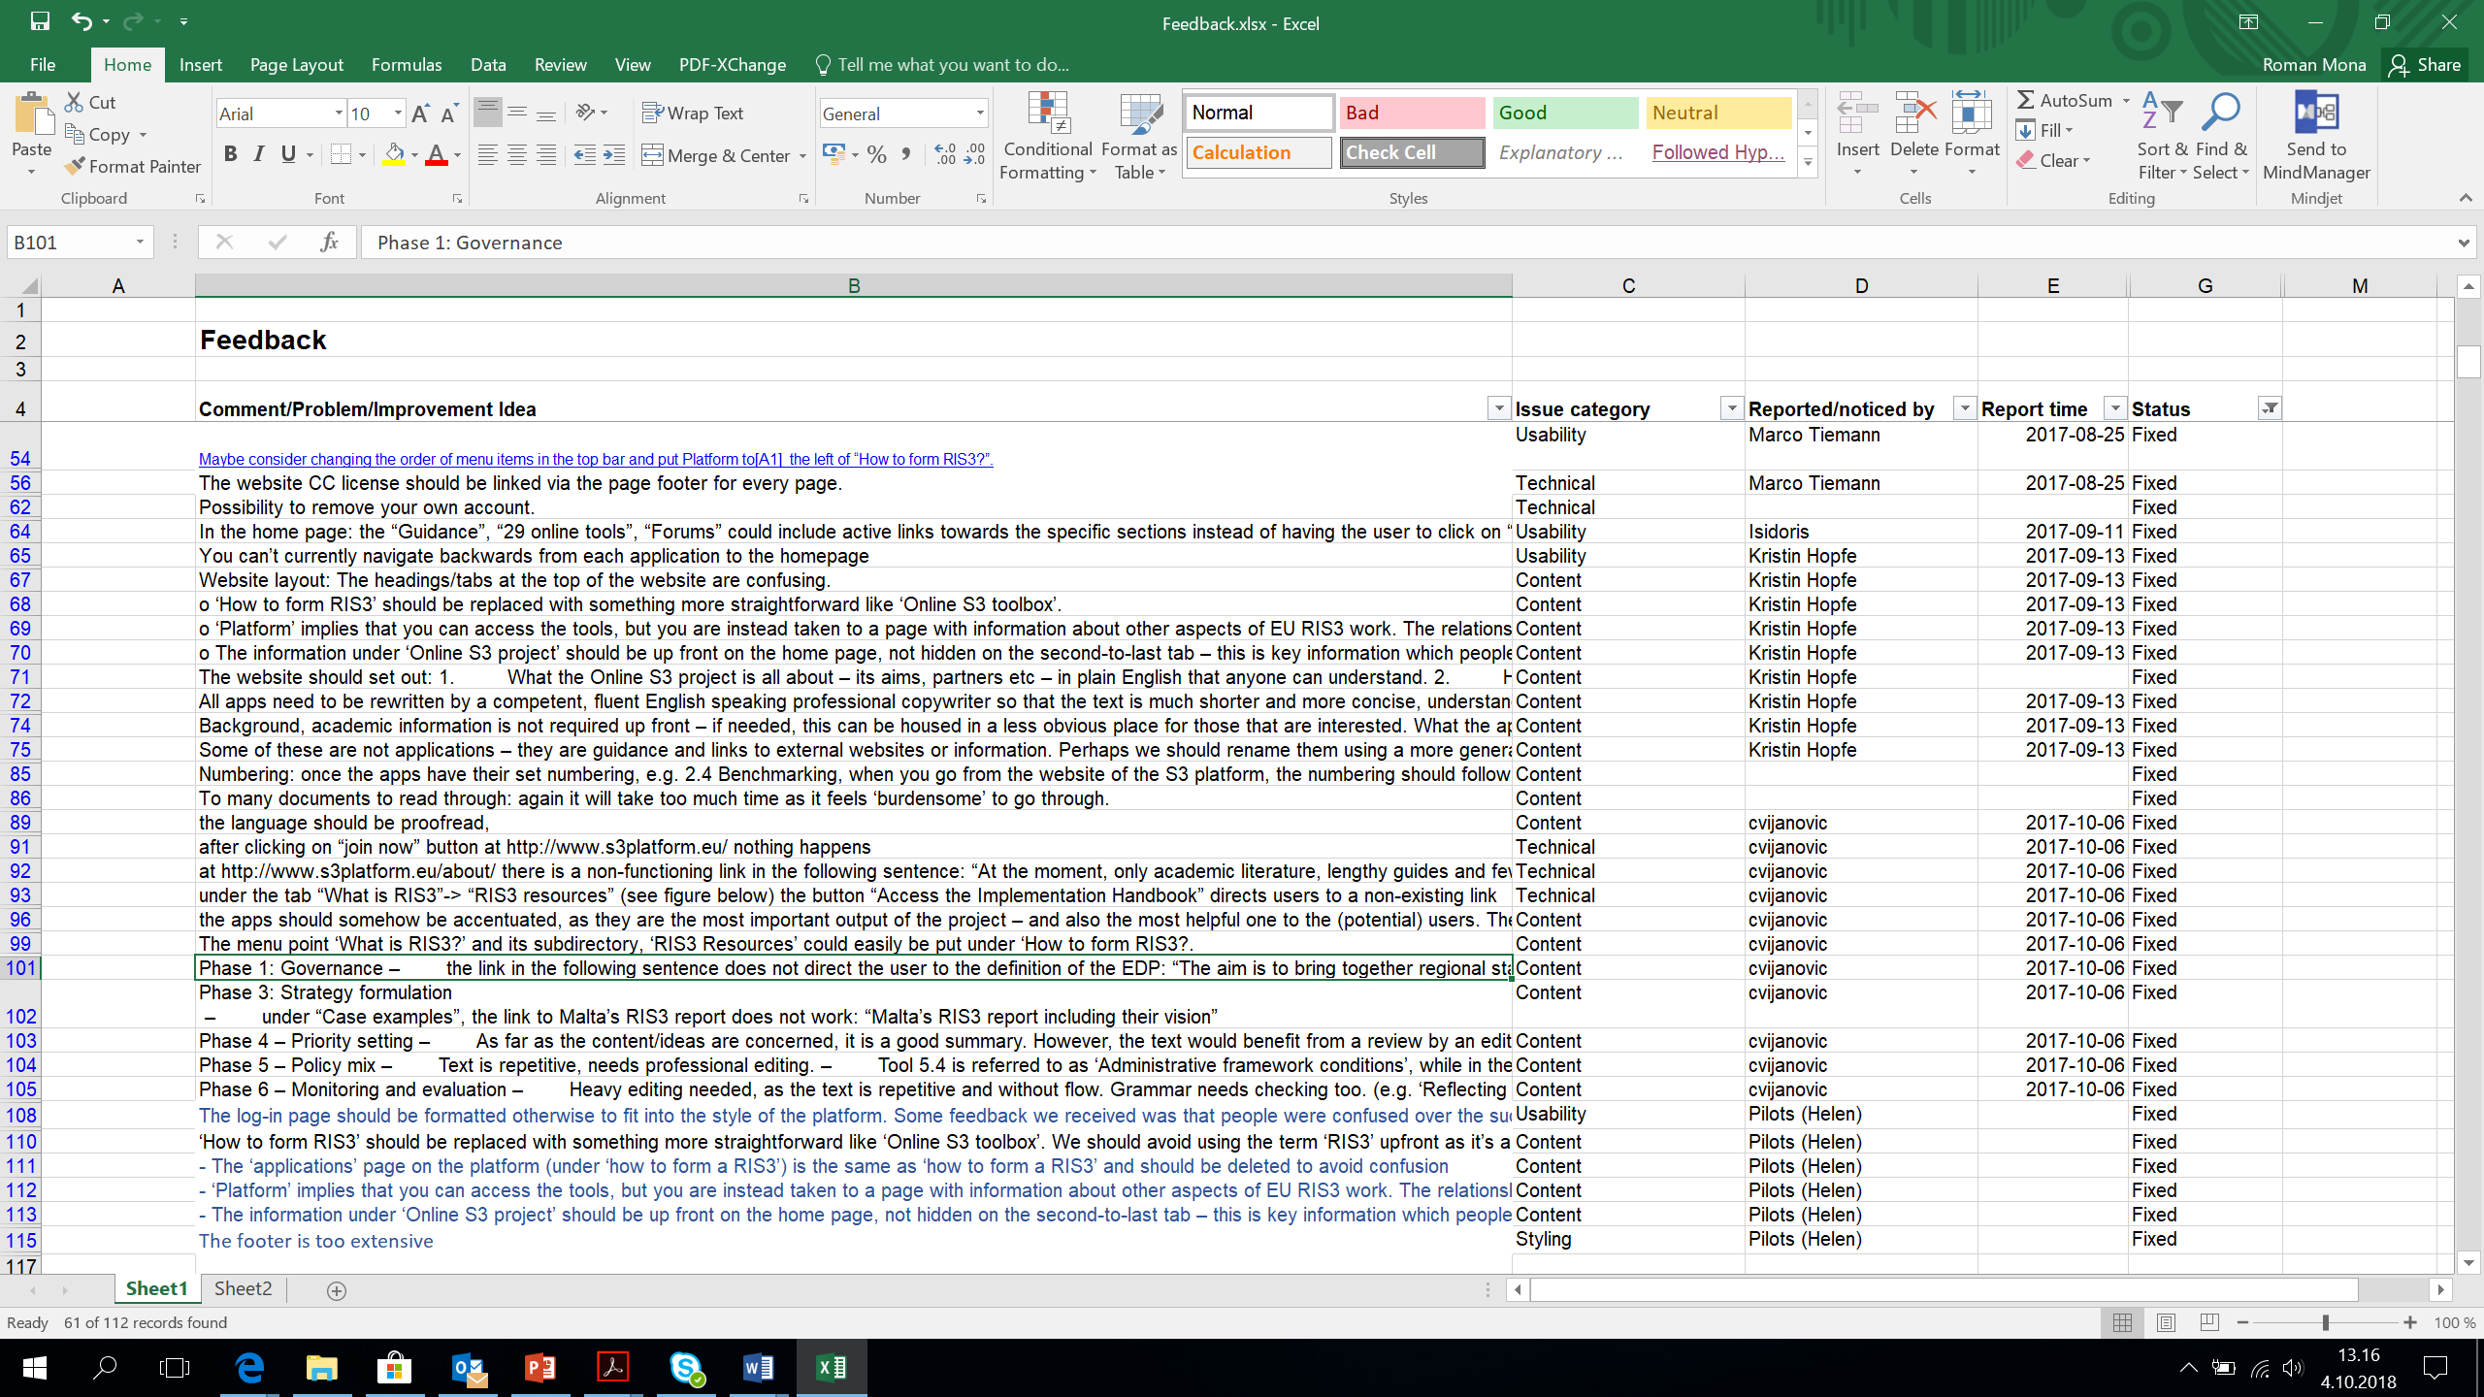
Using the feedback
Fixing the issues one by one (over 100 requests received for platform improvements)
IIL performed the language check for the platform in November 2017

Slide 28
Conclusions

Slide 29
Meeting the objectives and tasks of WP4
OBJECTIVES To create, adapt, and integrate the online tools and services, which will enable the implementation of the 18 different methodologies of the RIS3 guide. To improve the online tools and services based on the feedback from the users. | Realised
Task 3.1: The task includes the design of the applications that will provide the 18 services which correspond to the RIS3 guide for the development of Smart Specialisation Strategies as well as the adaptation and customisation of existing tools and services where appropriate. | 28 services and 4 roadmaps were designed and developed
Task 3.2: The development process will be supported by a series of quality assurance procedures, such as (1) Corrective and Preventive Actions; (2) Internal Quality Audit; (3) Detection and handling of non-conformities to specs; (4) Satisfaction of stakeholders and users; (5) Management of complaints; (6) Each application and tool will be accompanied with documentation and tutorial(s) | 152 internal recommendations for improvement were addressed
Task 4.3: Second cycle of design and development based on conclusions from the pilots | >600 recommendations from the pilots were addressed

Slide 30
Meeting the objectives and tasks of WP3
OBJECTIVE The aim of the WP3 is to develop the project’s platform which will integrate methodologies, tools and applications in order to provide the envisaged online services. | Realised
Task 3.1: Platform Design Definition of architecture and the specification of the implemented functions and features | Development of a single point of access for RIS3 knowledge-based policy advice in the EU.
Task 3.2: Development of the Platform Construction of the software by custom components on top of off-the-shelf open source solutions | Taking care of security and privacy issues, and offering potential for scalable, reusable and sustainable results. Providing a Forum for inter-regional discussion between various stakeholders
Task 3.3: Interoperability and interconnection between the platform and the tools Bringing together and connecting the different developed tools and apps of WP4 | Providing easy-to-understand guidance on RIS3 and its development process (six phases) Offering RIS3 roadmaps that allow different types of self-interest agents to perform effective knowledge-based decision making at different stages of the RIS3 strategy

Slide 31

http://www.onlines3.eu
Thank you for your attention

